Slide 1
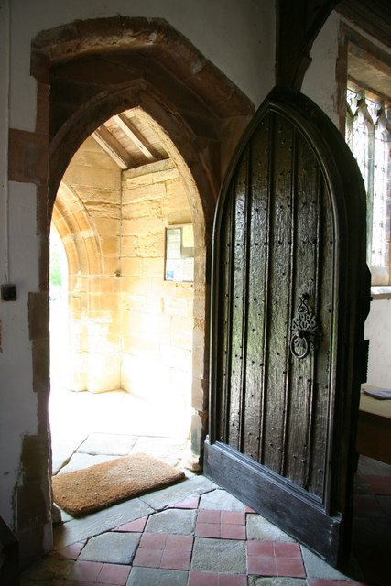
What doubts or closed doors limit your ability to show compassion to others?
How does the Holy Spirit guide you in forgiving and retaining sin?

Slide 2
How does the presence of the Holy Spirit help you to have faith?
Recall a time when you stood in faith even though you were fearful.

Slide 3
Recall an experience that initially crushed you completely – and ultimately strengthened your faith.
What happens inside you when you hear the witness of someone else? How does your response vary depending on the person, situation, or message?
How do you hold the horror of
Good Friday with the glory of Easter?

