Slide 1
Just a moment…
for technical reasons…

Slide 2
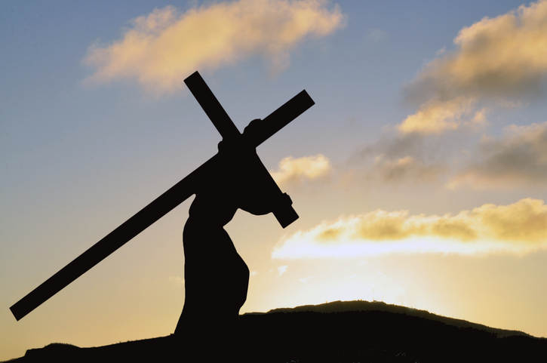
If you have been unjustly accused of something, how did you respond then? How would you respond now?
If you have ever been justly accused of something, what were you expecting or willing to endure?

Slide 3
Just a moment…
for technical reasons…

Slide 4
Have you ever washed your hands of something, choosing to not deal with the situation? Looking back now, how do you feel about your decision?
How are you influenced…or not…by the persuasiveness of an individual or a crowd?

Slide 5
Just a moment…
for technical reasons…

Slide 6
Like Simon, if you have ever been pressed into service, how did you feel? How were you changed…or not?
In what ways are you called into service… to console or help someone in their agony today?

Slide 7
Just a moment…
for technical reasons…

Slide 8
What does it mean for you to trust in God?
If you feel as if you have not been rescued by God, how does this affect your belief?

Slide 9
Just a moment…
for technical reasons…

Slide 10
When have you felt abandoned or descended into a darkness that caused you to feel forsaken?
How does the Spirit of God guide you in your own journey of the cross?

