Slide 1
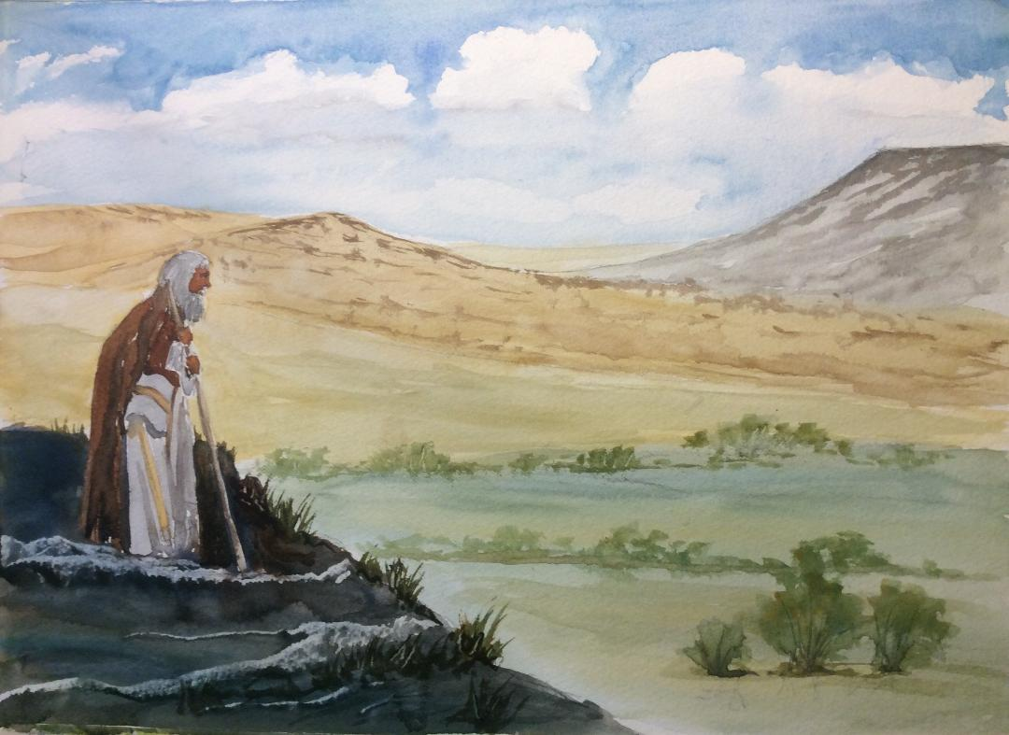

Slide 2
To whom do you relate in this story: the runaway son, the returning son, the father, the older brother, the unmentioned mother?
The son returned home, not because his relationship with his family was mended, but because he was hungry.
What hungers are calling you home - to God, to self, to others? How do you need to come home?

Slide 4
How would you end this story?

Slide 6
How does this ending help you appreciate the parable differently?
If you received less than a sibling or a colleague and thought that you deserved more, how would you feel and how would you resolve the situation?

