Slide 1
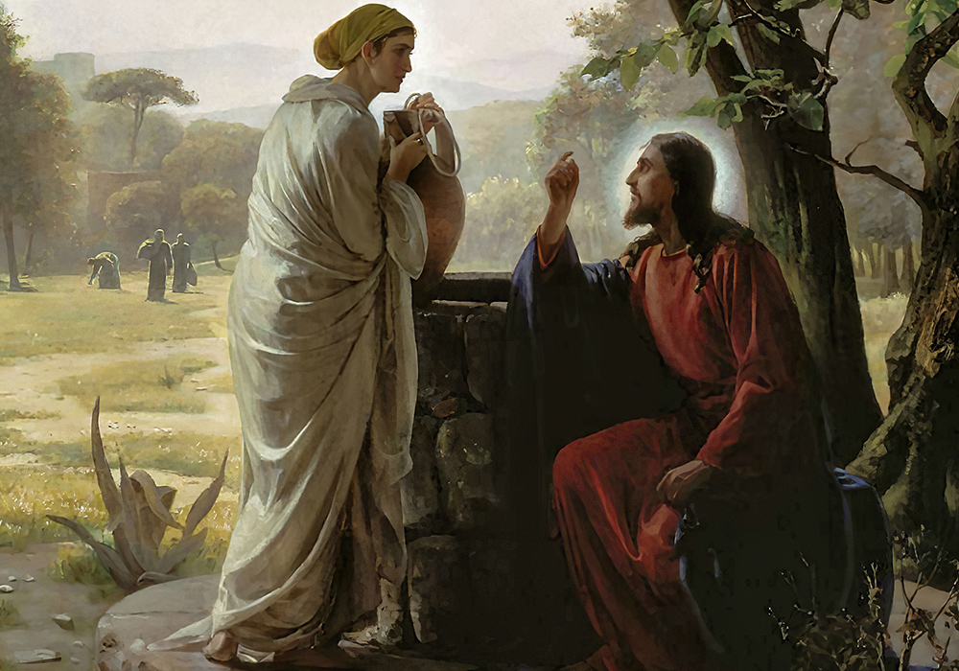
Imagine yourself as the woman at the well. How would you respond to Jesus?
Who in our society is saying, “Give me a drink”? What is your response
to this person?
Jesus is violating many norms
with this conversation.
When have you felt dismissed
because of social norms?
What social norms obscure
your own ability to hear someone
saying “Give me a drink”?

Slide 2
How do you feel about God
being vulnerable and seeking
a relationship with you?
Like Jesus, have you ever thirsted for someone you knew
to be moved by God’s own Spirit?
In what guise has a Photina come
to you, enthusiastically inviting you to living water?

Slide 3
How do today’s reflections help you thirst for something more satisfying than material things?
What well(s) do you tend to draw water from, even if it does not give lasting satisfaction?

