Slide 1
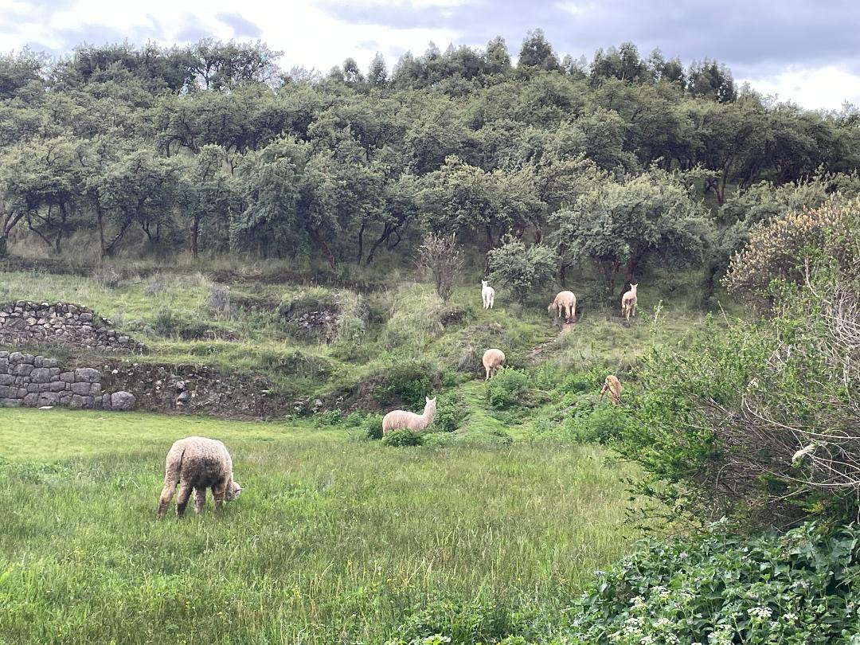
What shepherding do you long for in your life?
What abundant harvest do you see that is ready and waiting for laborers? How then are you to respond?
Jesus sent out the apostles to minister with miraculous compassion. What are your own ways of compassionate ministry?

Slide 2
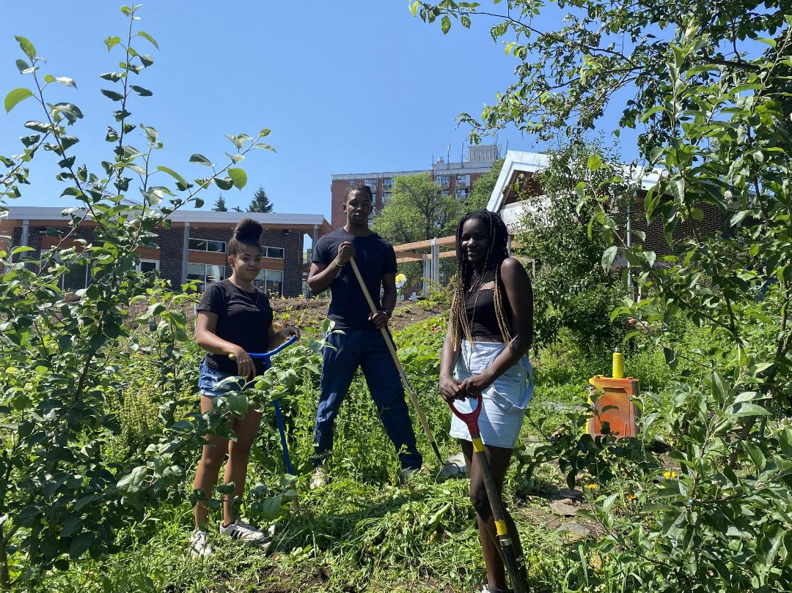
Alonzo
What changes in how you act when you hear that you are to have “authority that comes from compassion”?
How did you, or how could you, develop a habit of “looking at one another with hope”?
What would it take for you to “look at the world as it could be” and see “a great harvest!” instead of the disasters that news media focus on?

Slide 3
For whom do you find it hard to experience compassion? What might you do differently?
Think about a time when you experienced compassion for someone you thought of as an enemy.
Talk with God about what happens inside you when you believe someone is seeking “to be happy and overcome suffering” at the expense of others. Speak honestly to God and listen carefully.

