Slide 1
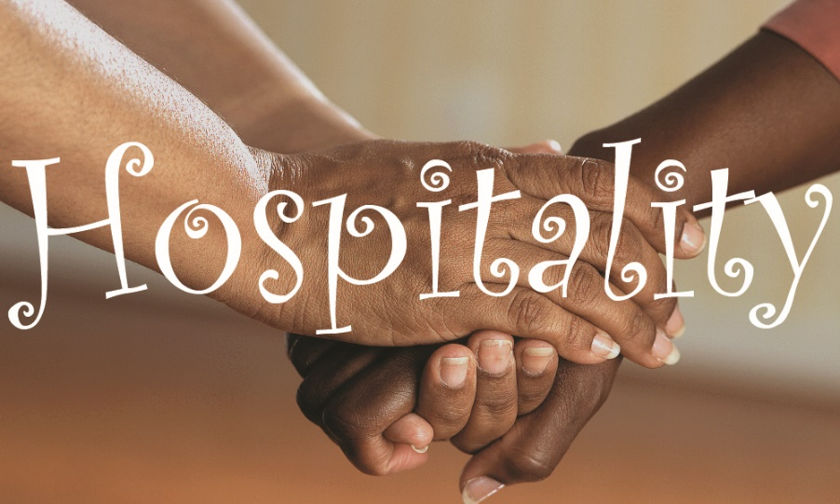
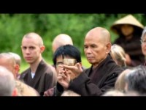
What might you offer to a loyal friend who has given you food and a special place to stay whenever you are in town? How might you pray for this hospitable person?
How would you react in prayer to your neighbor who has giving you hospitality? Or what you say?
What would you offer to a stranger who has lost home and/or family? How do you react to the family needing so much? How would you pray?

Slide 2
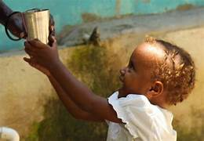
What is your first reaction when hearing this gospel reading? What might you say to the person next to you? Or how would you pray?
In reflection how do you respond to: “Whoever receives you receives me, and whoever receives me receives the one who sent me”?
How would you offer a prayer in response to Matthew, who gives us this mandate?

Slide 3
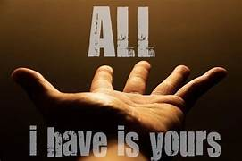
How do you react to dying to self? How do you feel about your response?
What does dying to self, or giving of self, mean in your life? How might you pray for this ability, this gift?
The pastor says: It’s through this strange paradox of dying to ourselves that Jesus says we truly find life, the greatest life possible. How could you pursue this gift? How do you feel in your heart?

