Slide 1
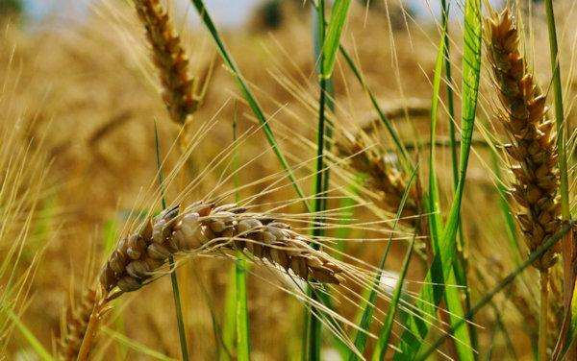
What is comfortable or uncomfortable to you about the image of God in this parable?
What new understanding of yourself have you discovered in this parable?
Where are you having a
difficult time separating
the good wheat in your life
from the life-threatening
darnell?

Slide 2
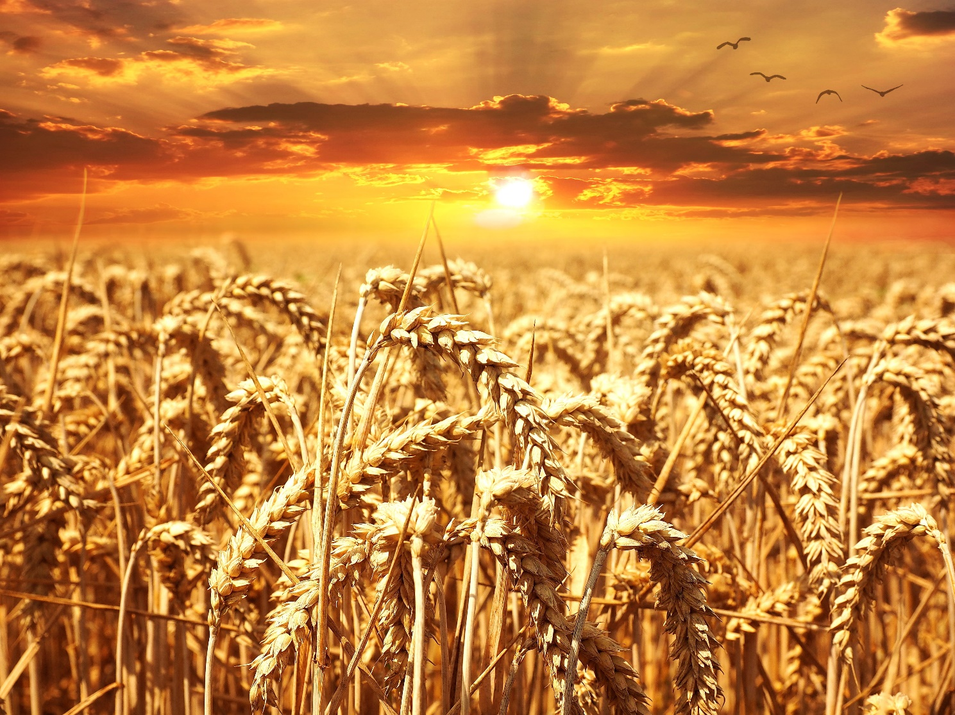
Looking back at how you have grown and changed in life, where are you grateful for God’s merciful patience and slowness to judge?
When have you wanted to
act quickly, only to realize
it is better to wait and
not judge?
How can you make this
patient discernment
part of your ordinary life?

Slide 3
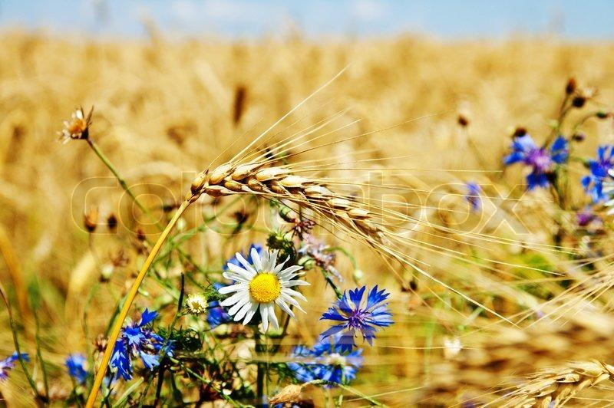
When have you judged something to be evil, only to find out that it has a good to offer if you think about it differently?
What helps you to see everything as coming from God and having a purpose?
When do you stop trying to
fix things and simply
look at what is, both wheat
and weeds, with gentle eyes?

