Slide 1
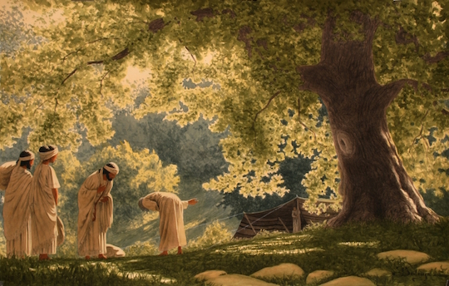
Traveling in this arid land, what would you say to Abraham as you also enter this scene?
If you were Sarah being told to prepare for a feast and then watching this encounter between the men and Abraham, how would you feel or what would you say to yourself?

Slide 2
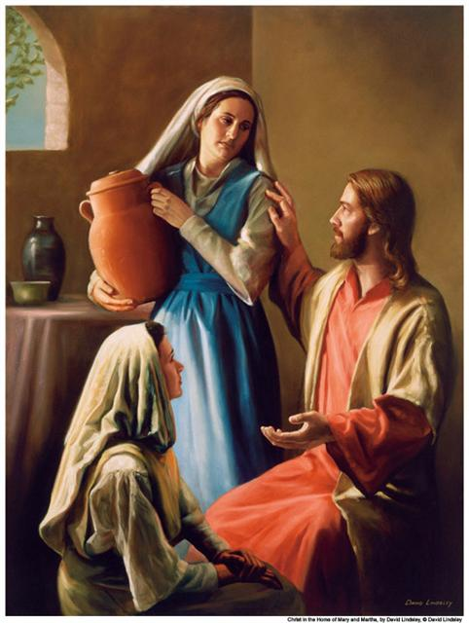
Reflecting on the similarities in the Genesis reading and Luke, how do you respond?
As Mary, how are you affected by Jesus’ response to Martha? - or –
If you were Martha, how would you feel?
Think ahead to next Thanksgiving. If you are the host welcoming people to your celebration, or an invited guest, how might you feel different from past occasions?

Slide 3
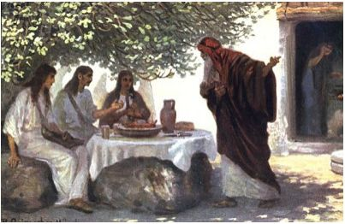
Reflect on Sr. Mary’s statement: “…we need to find the balance between action and contemplation.”
After pointing out that Mary was not following the norm regarding women being denied education, Sr. Mary says, “Perhaps the deepest conflict reflected here is not the difference between the sisters but the consternation of a community trying to adjust as Christian women assumed previously restricted roles of religious leadership.” How does this resonate within you?

