Slide 1
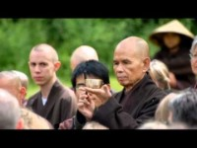
How has your understanding or experience of the Word of God changed -- or changed you?
What are the ordinary ways you water the Earth today with the Word of God?

Slide 2
What is the condition of your soil?
What does the soil of your life need now?
Recall a time when you have been the sower.
In what ways have you been generous or
in what ways you have you withheld the seeding?

Slide 3
How have you embraced or resisted learning the “language of silence”?
Think of a time when you knew or were known beyond words. What feeling does this memory
bring to you today?

