Slide 1
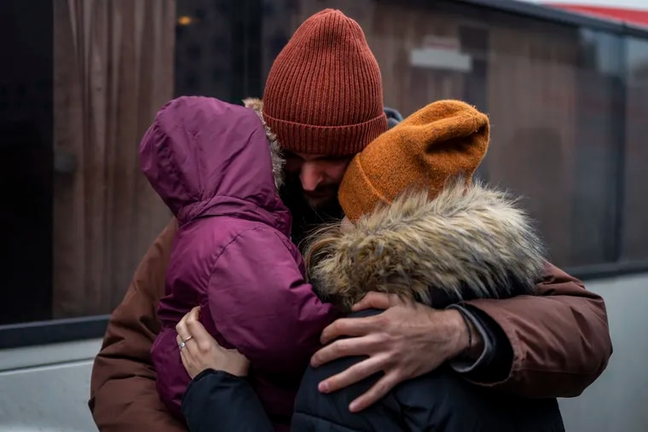
The 1st Station: Jesus Is Condemned To Death.
Compassion asks us to go where it hurts,
where the lives of Ukrainians are attacked, their home life is disrupted, and where their streets and towns are reduced to rubble. Suddenly millions of innocent families face displacement, as their courageous men take up arms to bravely defend their homeland.
In silence Jesus accepts his unjust condemnation of crucifixion.

Slide 2
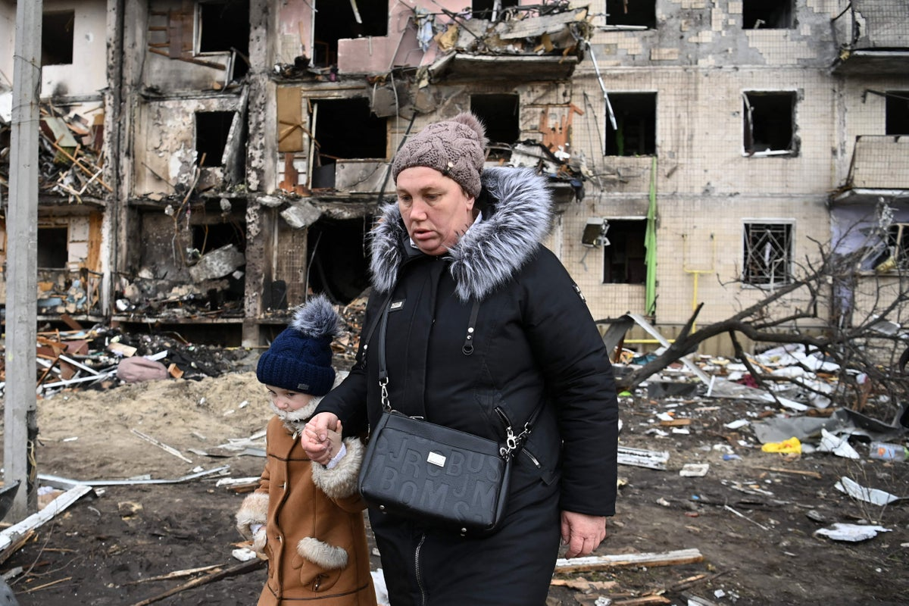
The 2nd Station: Jesus Is Given His Cross.
Compassion takes us into places of pain…
into the pain of anxiety, fear, and uncertainty. This woman must be strong for her child even as she asks, why this imposed suffering? Why us good families?
Jesus did not choose his cross, it was given to him.

Slide 3
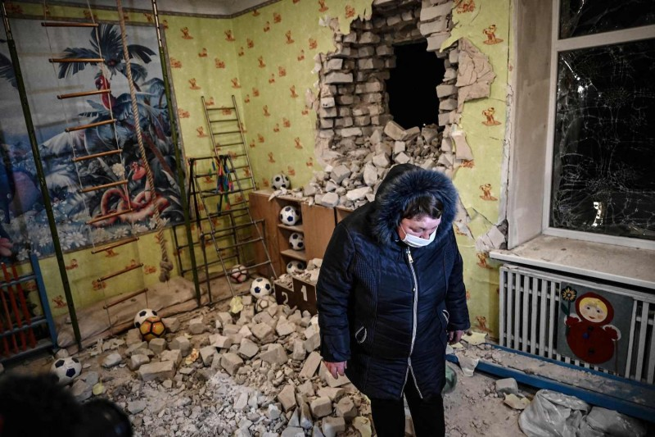
The 3nd Station: Jesus Falls the First Time.
Compassion calls us to share in brokenness, confusion, and anguish.
At times we cry, “Merciful God, this burden is too heavy to carry. Please give us strength to stand strong. We pray.”
Jesus suffered humiliation, but he sanctified this moment by rising … and he continued to carry
his cross.

Slide 4
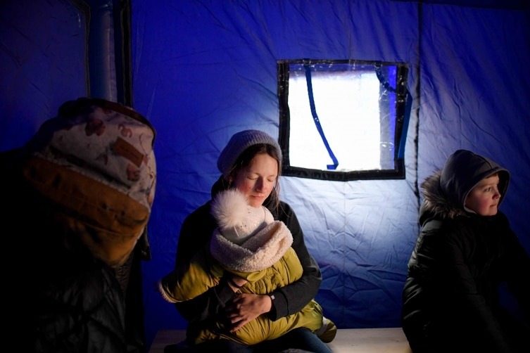
The 4th Station: Jesus Meets His Mother.
Compassion causes a mother to reach out and console the child of her womb.
“Holy Mary, your love and comfort is needed for the displaced mothers of Ukraine, and their precious children.”

Slide 6
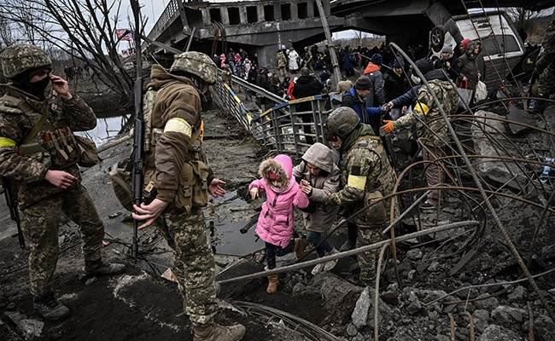
The 5th Station: Simon of Cyrene Helps Jesus Carry His Cross.
Compassion inspires us to reach out to those in need.
“During these days of displacement, we meet people embracing and welcoming us. They offer food, shelter, and safety.”
“Jesus, bless the strangers who help us with their kindness and goodness.”

Slide 7
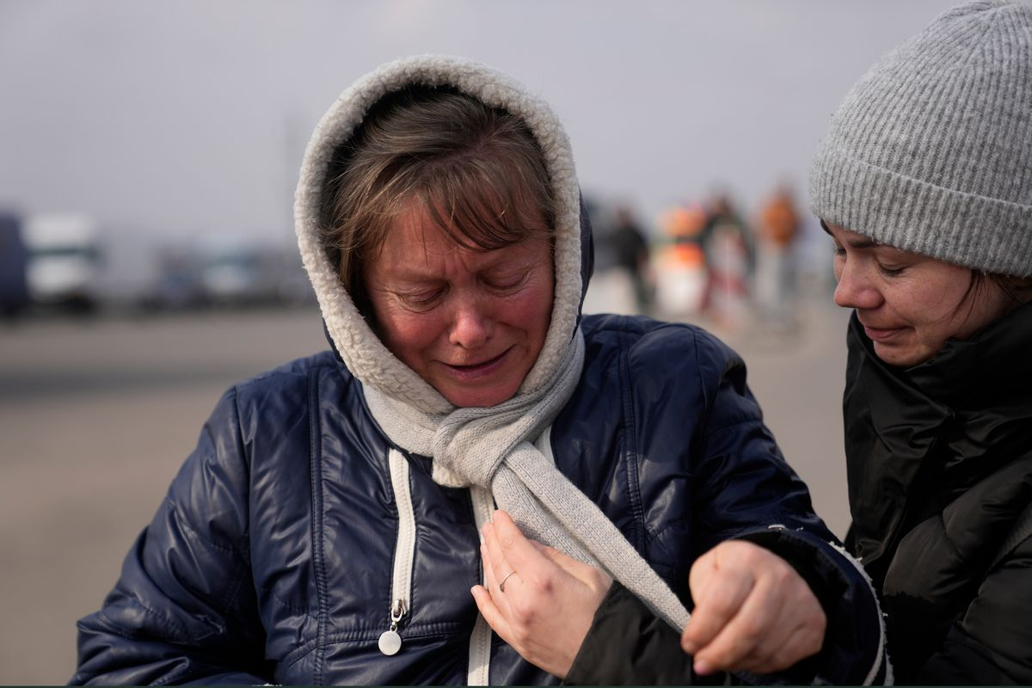
The 6th Station: Veronica Wipes the Face of Jesus.
Compassion asks me to forget myself and to see the need of the person who suffers.
A woman steps up and offers a cloth to wipe the bleeding face of Jesus. Unexpectedly, she is rewarded.
“Jesus, how many times I have been upset, because the person to whom I gave a kindness, did not express gratitude. I ask for forgiveness.”

Slide 8
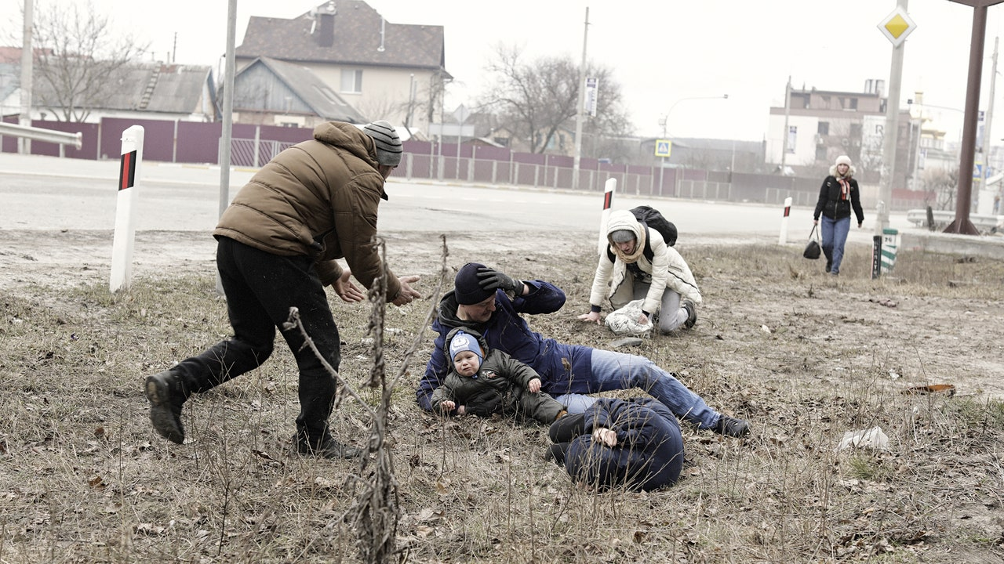
The 7th Station: Jesus Falls for the Second Time.
Compassion requires us to be weak with the weak, to mourn, and be vulnerable with the vulnerable.
“There is something holy about being human, about drawing on inner strength and not giving up.”
Jesus, you have shown us the way to fall a second time, by courageously standing up and carrying your cross, no matter the pain and humiliation. I ask for courage to do the same.

Slide 9
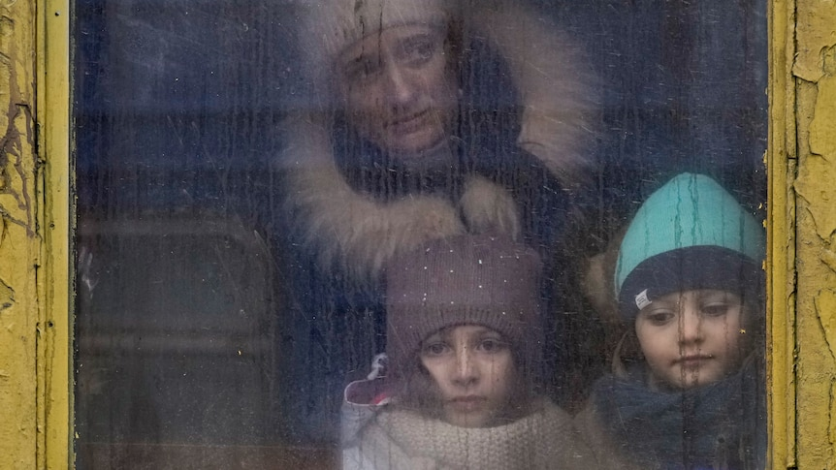
The 8th Station: Jesus Meets the Women of Jerusalem.
Compassion challenges us to weep with those in tears.
“We all are sharing a great loss. It is not shameful to cry about the destructive loss of our homes and belongings. Our brave husbands are risking their lives to save our country. Our children are confused and frightened. One day soon may this weeping and sadness end in joyful song and dancing. We hopefully pray.”

Slide 10
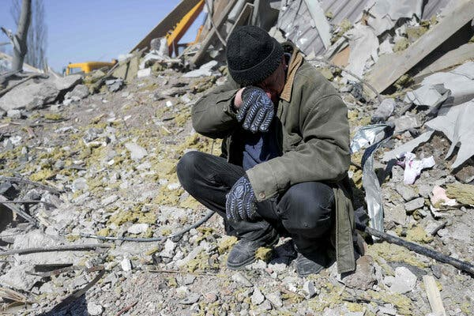
The 9th Station: Jesus Falls for the Third Time.
Compassion challenges us to stand up for what we believe.
“Jesus, because of your passion and death, you give us the courage and strength to defend our beloved country and our displaced families. Jesus, be with us until the end of this horrific assault. We know we are strong because of your unconditional love for us.”

Slide 11
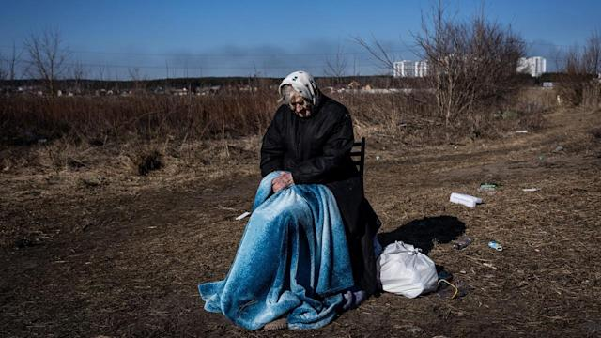
The 10th Station: Jesus Is Stripped Naked.
Compassion calls us to be vulnerable with the vulnerable.
“We are being stripped of everything we hold dear. Our family life, our cities, our beautiful homeland. We are surrounded by devastation and rubble. In you, dear Jesus, and holy Mother Mary, we place our lives and homeland.”

Slide 12
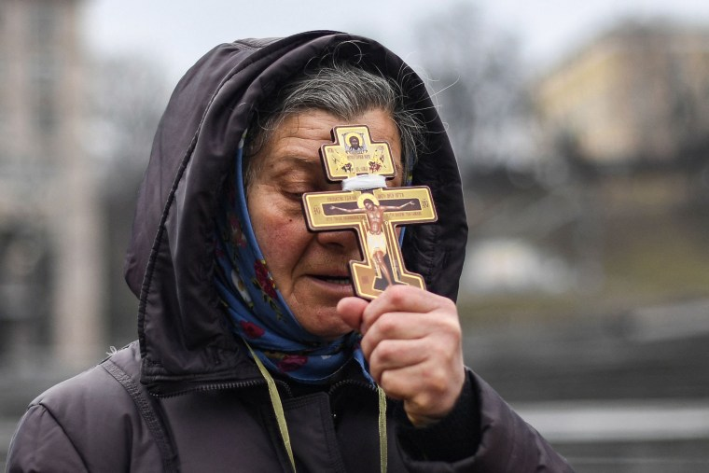
The 11th Station: Jesus Is Nailed to the Cross.
Compassion requires us to look upon the suffering son of God and to embrace our cross -- this excruciating cross that has been imposed on us.
“Holy Mother Mary, as we suffer so many losses, be with us now, and at the hour of our death, we pray. “

Slide 13
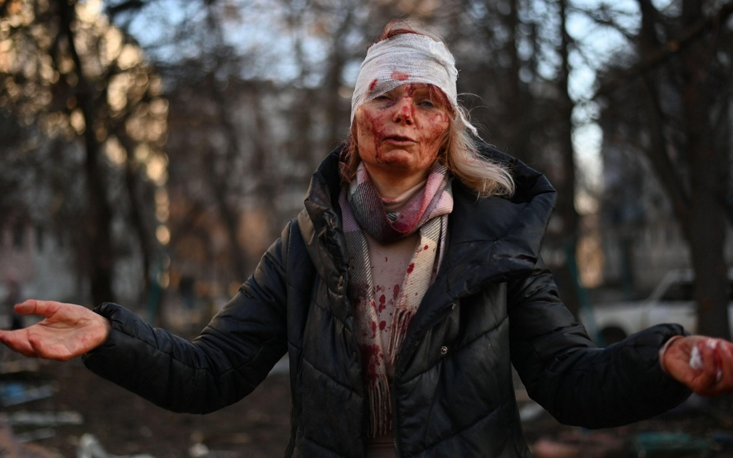
The 12th Station: Jesus Dies on the Cross.
We pause to reflect as we listen and mourn the wounded, the assaulted, the raped, the dying, and the dead of Ukraine and Russia.
“Jesus, and Mother Mary, bring them home to you. We pray.”

Slide 15
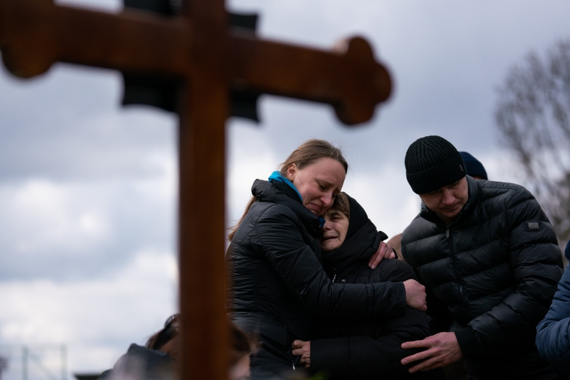
The 13th Station: Jesus Is Taken Down from the Cross.
Compassion means full immersion in the condition of being human.
“Jesus, you comfort and console us knowing that because of your passion and death, you are with us at all times,
especially when we suffer, die, and rise to new life.
For this we are deeply grateful.”

Slide 16
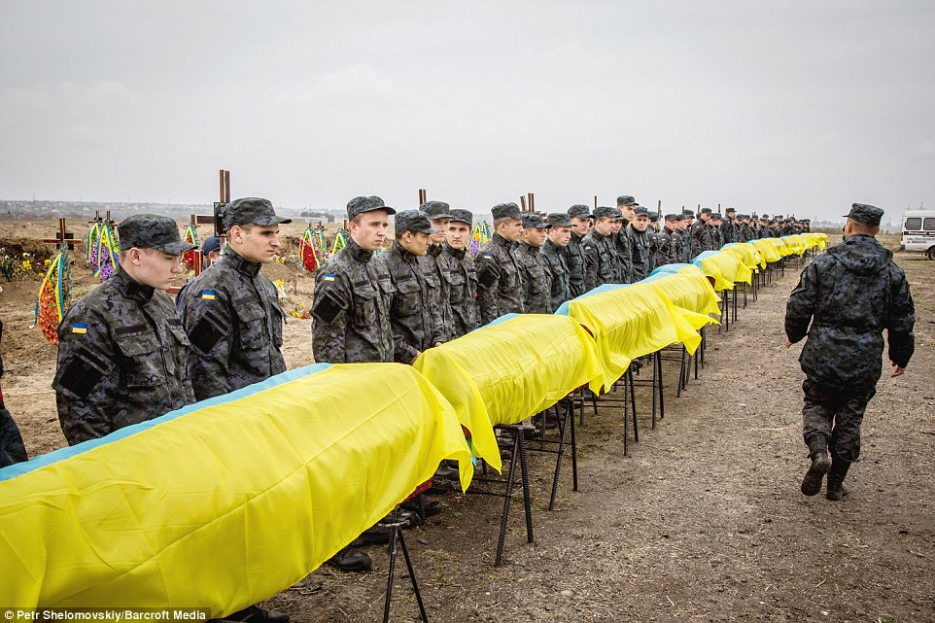
The 14th Station: Jesus Is Placed in the Tomb.
Jesus, unjustly condemned, abandoned and alone, you took upon yourself the guilt of humanity.
Let us pause to remember the thousands who died bravely and courageously defending their homeland and loved ones, as well as those victims who were killed randomly and without mercy.

Slide 18
“Every human act,
every Christian act, is an act of hope.
But that means we must be women and men of the present,
we must live this moment --- really live it, not just endure it --- because this very moment, for all its imperfection and frustration, because of its imperfection and frustration,
is pregnant with all sorts of possibilities,
is pregnant with the future, is pregnant with love,
is pregnant with Christ.”
-- Walter Burghardt, S.J.

Slide 19
Jesus, our brother, and holy Mother Mary,
we place our trust in you,
and beg for the conversion of the Russian people, and their leader –
and for our own conversion as well.
We hopefully pray.

Slide 20
