Slide 1
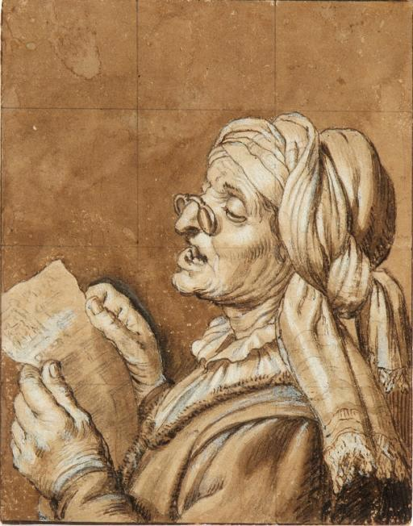
When has an experience moved you to “sing joyfully” in your heart?
How has turning to God in prayer liberated you?
How does it feel to hear that Yahweh is singing joyfully because of you?

Slide 2
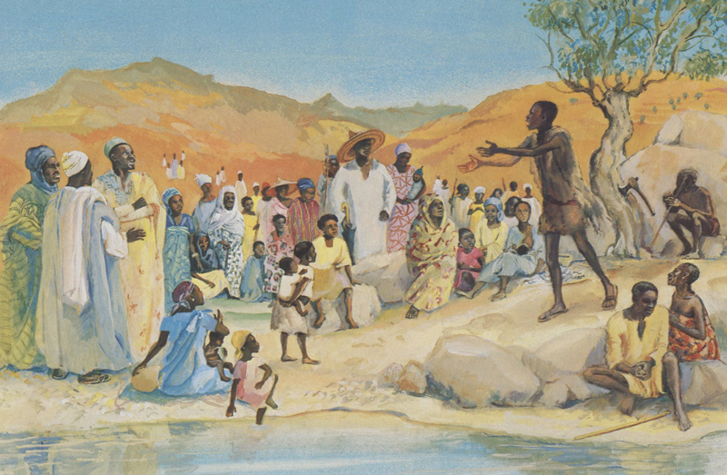
With what hopes for charity and justice has the Spirit been filling your heart?
How has the Spirit been filling your heart and mind to answer the question: “What should we do?”

Slide 3
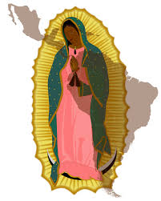
How do you apply John’s instructions for reform
to the structures that are part of your life?
What signs have you seen of love and justice emerging in response to the agonizing concerns of our day?

Slide 4
