Slide 1
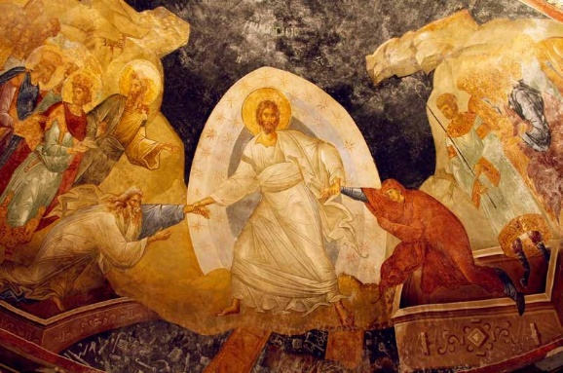

Slide 2
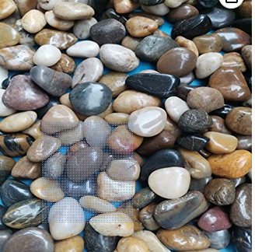
Reflect on something you find hard to forgive in yourself or in others. What would be different for you if you could find that forgiveness?
What stone is calling to you to
remove it? Imagine your life
without it.
How will you spend time with Jesus, who is calling you to resurrection?

