Slide 1
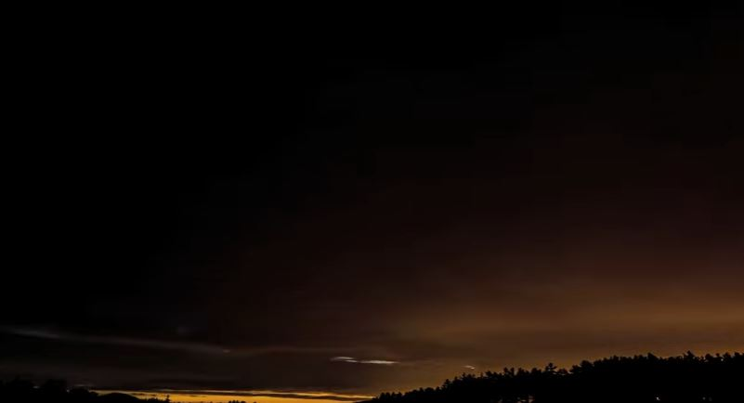

Slide 2
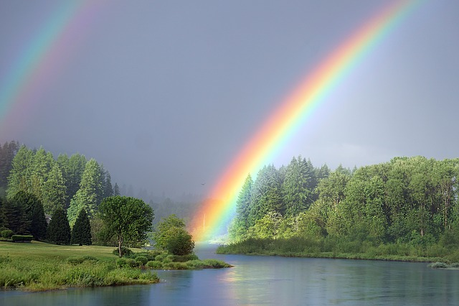
God’s covenant is a mutual agreement between God, us, and all of creation. How do you live out your part in this covenant?
What is your role in transforming the brokenness caused by a breach in the covenant?

Slide 3
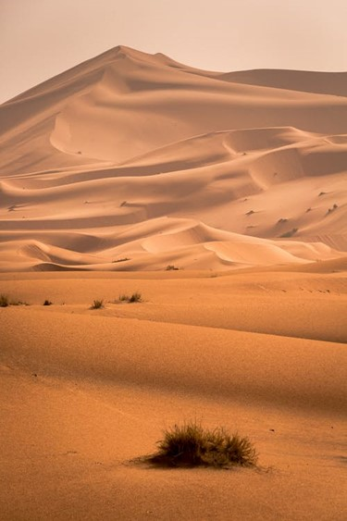
Reflect on the occasions or situations that tempt you to sin, and how do you deal with that?
How does believing the good news help you uphold your part of the covenant? How do your communities know you believe?

Slide 4
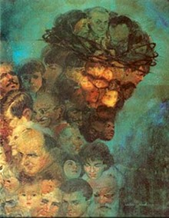

Slide 5
What is your sinfulness and how does it turn you from God and harm the community?
Imagine the image of a personal enemy or someone you dislike in the painting. How does this affect seeing Jesus in all people?

Slide 6
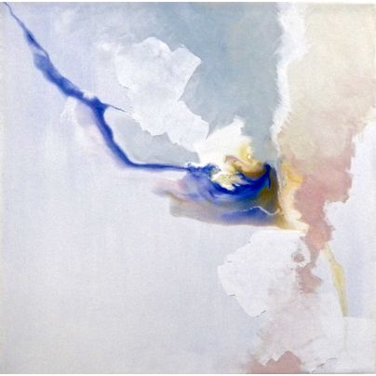
Take me as I am

