Slide 1
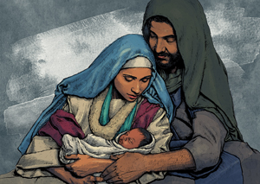

Slide 2
What part of Jesus’ life with Mary and Joseph
is especially meaningful for you?
How have the relationships in your family or
chosen family deepened during difficult times?
– as well as during good times?
How has this Christmas season been for you?
What has surprised you? What have you missed?

