Slide 1
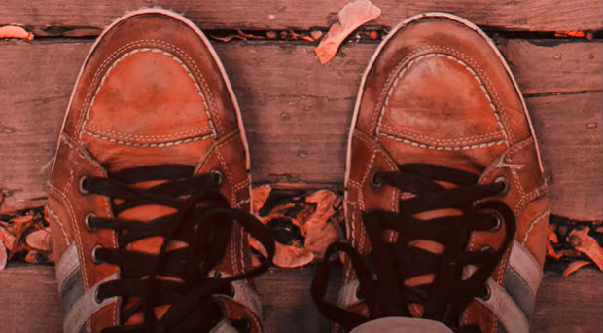
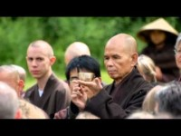
Consider a moment or time in life that you risked a “hostile stare” to respond to God’s call. “My yoke is easy, and my burden is light.” What does your heart say about this? When you have entrusted your struggles to God, what was it like for you to surrender your vision of the desired outcome?

Slide 2
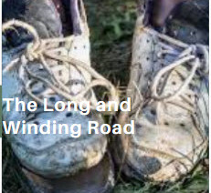
How was it for you when you had to exercise your TRUST muscle and lean into what God was calling you to do? How do you grow in surrendering your path to God’s direction? Reflect on a significant moment when you felt a divine summons to embrace the call to move and live and grow in your relationship with God.

Slide 3
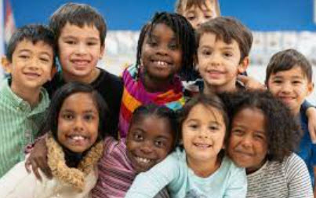
How is recognizing your limitations and embracing humility opening you to grow more free? Where are you on the continuum of little ones to learned ones? What would it take to move? What makes it hard for you to surrender your autonomy and let God hold you?

