Slide 1
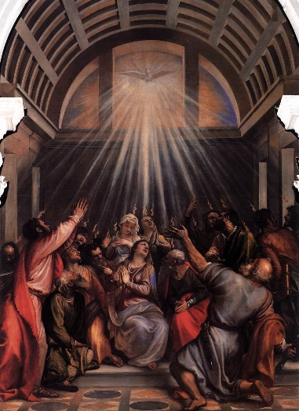
What are the barriers to
your love for others?
How do you overcome them?
What do you do when remaining hopeful
becomes a challenge?
How did you emerge stronger or wiser from
a stressful period?

Slide 2
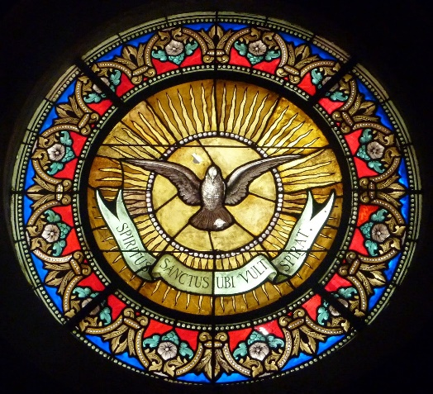
When has your heart been softened by the example or words of a holy person?
How has the Spirit been your interior teacher, guiding you to the truth?

Slide 3
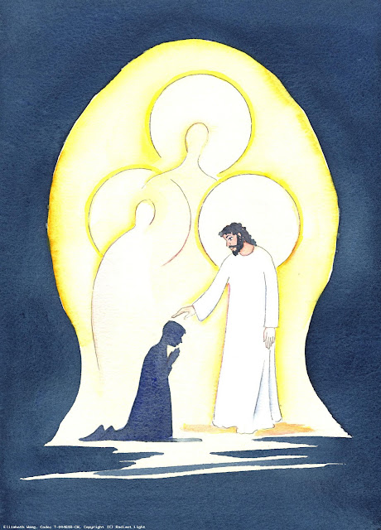
What names do you call our Triune God?
When has the energy of the Spirit uplifted you?
How does it feel to imagine hope that
does not depend on what you do, but on
your faith in God’s love pouring out to you?

