Slide 1
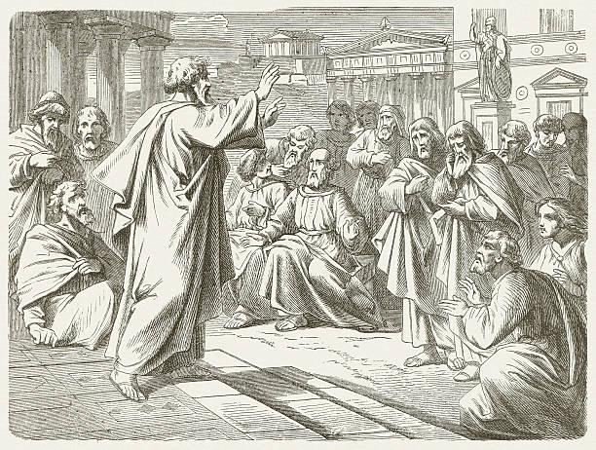
If you were announcing the wonder of Jesus’ being raised to life, what would you say?
What feelings do you have as you proclaim this good news?
If you were able to speak right now to the people of Russia and/or other countries waging war,
how would you proclaim this message from Acts?

Slide 2
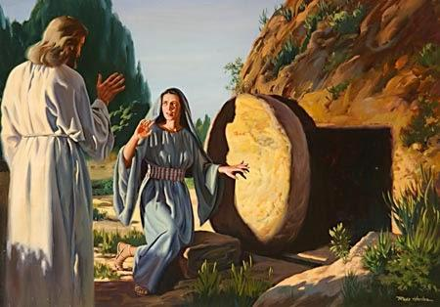
Put yourself in the scene. Recall Mary saying, “They have taken our Teacher!” How do you feel?
How does it feel to be Peter or the Beloved Disciple, who runs hard, stumbling and sweating, and then entering the tomb?
Imagine you are Mary. What is it like as you hear Jesus saying your name?

Slide 3
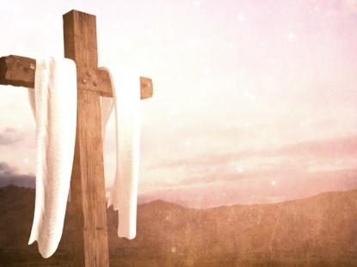
What reaction sparks in your innermost self in hearing: “We have hugged God to ourselves, and made the Creator a prisoner of our smallness of mind and hardness of heart”?
How do you feel as if you are trapped in your own tomb? What would it take for you to abandon it?
What feelings rise in you if you consider
Sister Joan’s words in relationship to the horrors of the war in Ukraine and elsewhere, even our streets?

