Slide 1
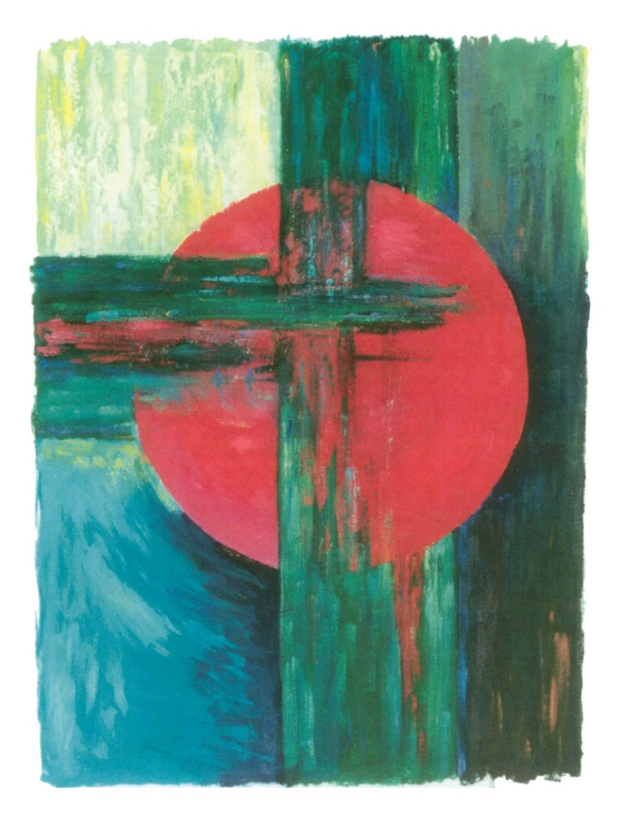
The First Word: FORGIVENESS
.
When they reached the place called The Scull, they crucified Jesus there and the two criminals also, one on the right, the other on the left. Jesus said,
“Abba, loving God, forgive them; they do not know what they are doing.” (Luke 23:33, 34)

Slide 2
Were you there when they crucified my Lord?
Were you there when they crucified my Lord?
Oh… Sometimes it causes me to tremble, tremble, tremble.
Were you there when they crucified my Lord?

Slide 3
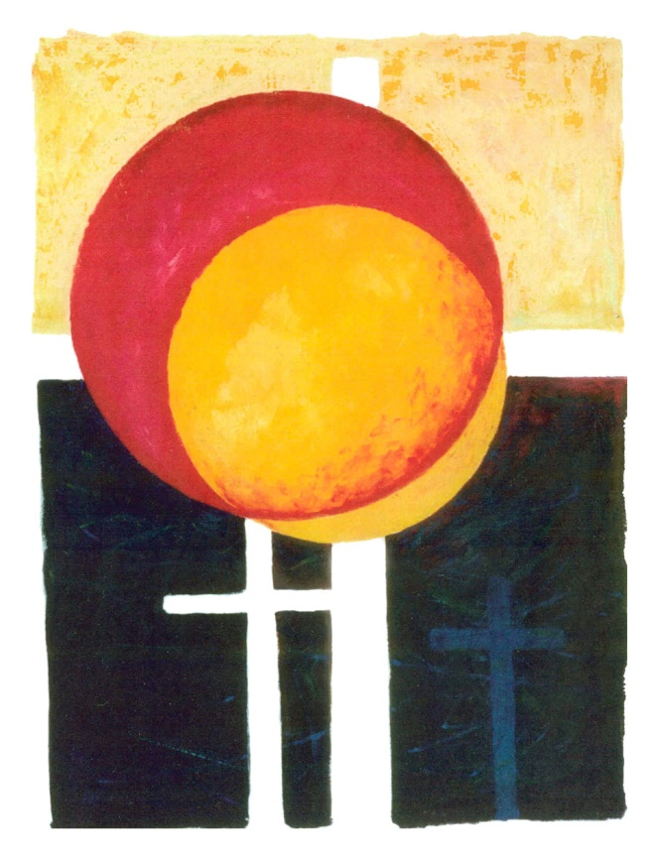
The Second Word:
ENCOURAGING ANOTHER’S GOODNESS, WHILE BEING TAUNTED
One of the criminals hanging there abused Jesus. “Are you not the Christ?” he said.
“Save yourself and us as well.” But the other spoke up and rebuked the first saying,
“Have you no fear of God at all? You got the same sentence as he did, but in our case we deserved it: we are paying for what we did. But this man has done nothing wrong.
Jesus,” he said, “remember me when you come into your reign.”
“Indeed, I promise you,” Jesus replied, “today you will be with me in paradise.”
(Luke 23:39-43)

Slide 4
The Third Word:
OFFERING COMFORT
Near the cross of Jesus stood his other and his mother’s sister, Mary the wife of Clopas, and Mary of Magdala. Seeing his mother and the disciples he loved standing near her, Jesus said to his mother,
“Woman, this is your son.”
Then to the disciple he said,
“This is your mother.”
From that moment the disciple made a place for her in his home. (John 19:25-27)

Slide 5
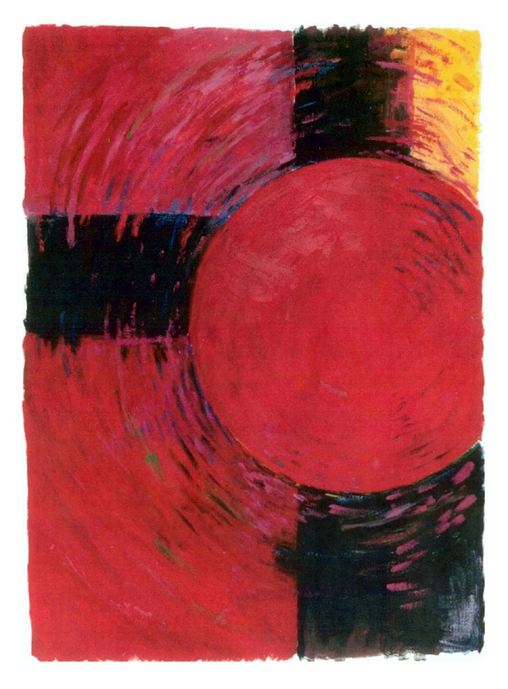
The Fourth Word:
THIRST
After this, Jesus knew that everything had now been completed,
and to fulfill the scripture perfectly he said:
“I am thirsty.” (John 19:28)

Slide 6
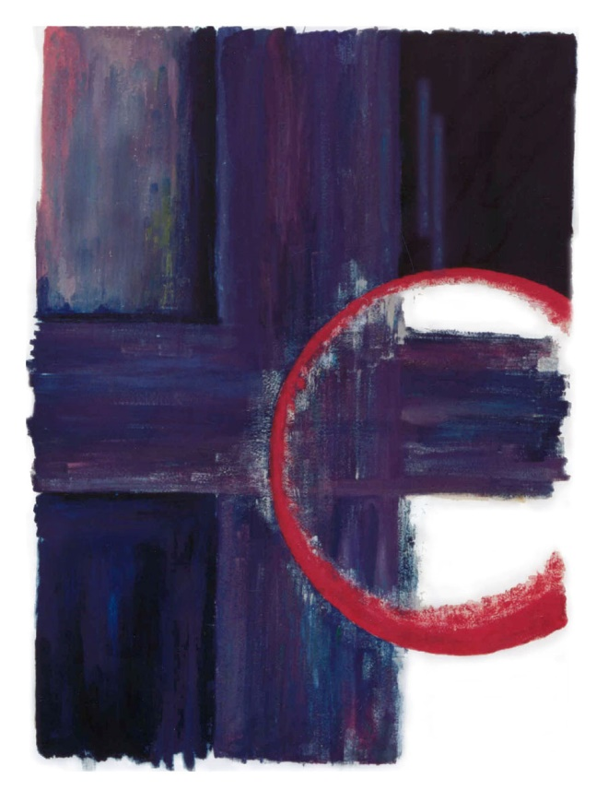
The Fifth Word:
FEELING ABANDONED / DESERTED / IGNORED
When the sixth hour came there was darkness over the whole land until he ninth hour.
And at the ninth hour Jesus cried out in a loud voice,
“My God, my God, why have you forsaken me?”
(Matt. 27:45-50, Mark 15:33-34)

Slide 7
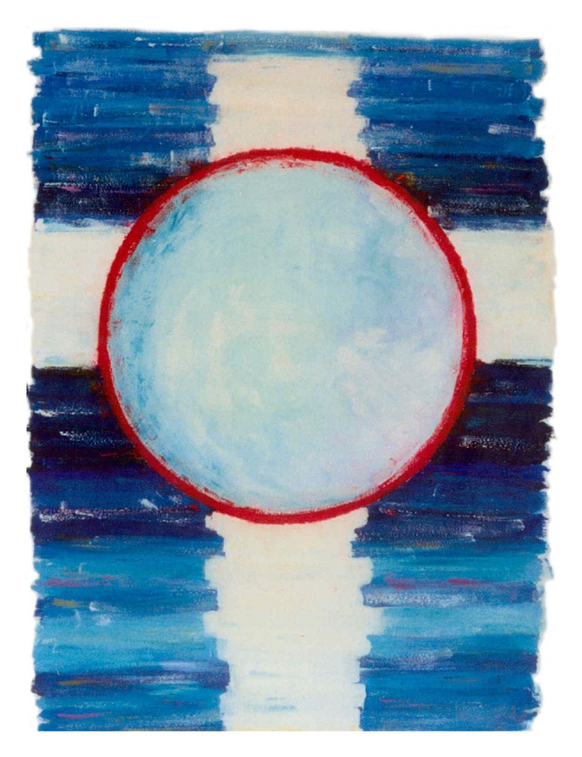
The Sixth Word:
RESIGNATION / SURRENDER
It was now about the sixth hour and, with the sun eclipsed, a darkness came over the whole land until the ninth hour. The veil of the Temple was torn right down the middle; and when Jesus had cried out in a loud voice, he said,
“Abba, loving God, into your hands I commit my spirit.”
(Luke 23:44-46)

Slide 8
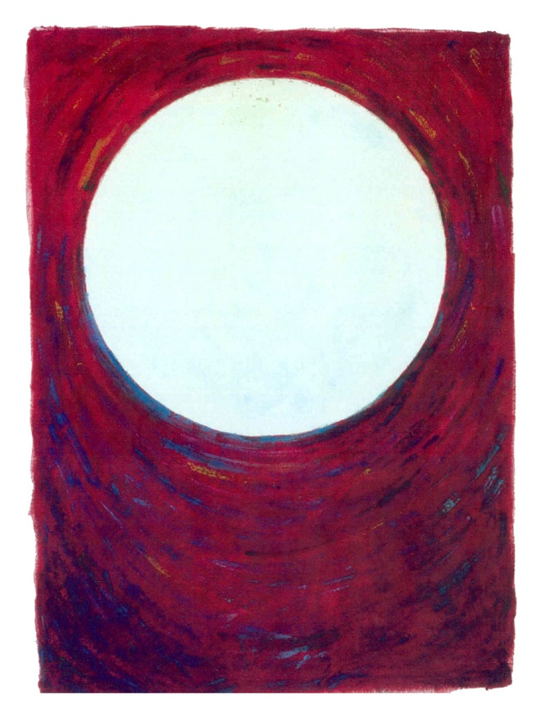
The Seventh Word: ACCEPTANCE
In solidarity with those who suffer and die from Covid, like Br. Chris from St. Camillus
After Jesus had taken the vinegar he said,
“It is accomplished”
and bowing his head he gave up his spirit. (John 19:29)

