Slide 1
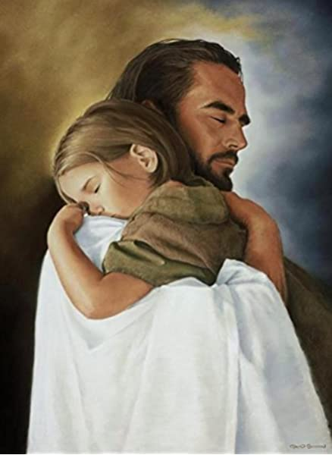

Slide 2
When has your sense of personal importance either helped or hindered your willingness to serve?
What does being the servant of ALL mean to you?

Slide 3
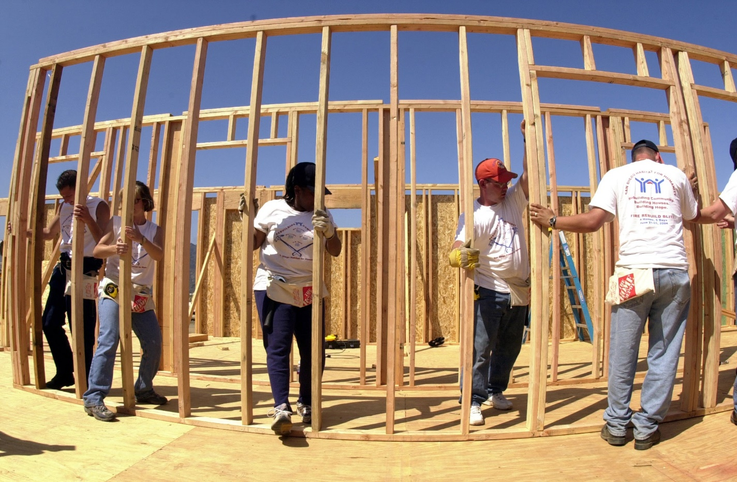

Slide 4
When have you ignored a need to serve because it was too menial?
How does it feel to
have your service
unnoticed?

Slide 5
When have you served
people who are utterly dependent?
If not, what holds you back?
How do your weaknesses and vulnerability affect your approach and attitude toward
the poor or weak person?

