Slide 1
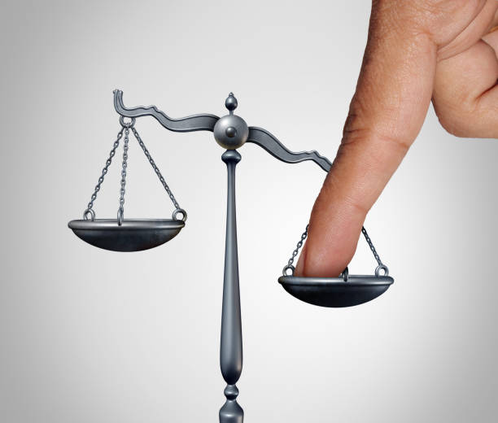
We have heard this story many times. How do you feel about the steward’s actions?
When have you been called to task by someone in authority and how did you respond?
The steward is hoping to change his relationships. How does justice figure into your own relationships?

Slide 2
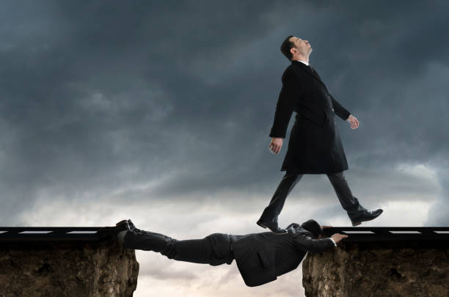
How does that perspective change your thoughts about the steward’s behavior or even your thoughts about some contemporary behavior?
Is that behavior perhaps just,
in the midst of injustice?
What is it you need to do today
to center
in your thinking and actions
those who are made poor or
disenfranchised by our
systems and structures?

Slide 3
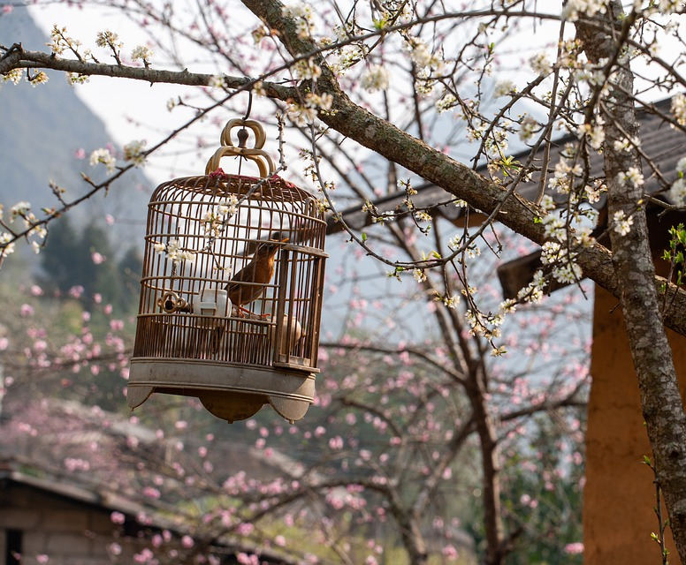
Ask yourself,
“Do I hear the caged bird?” (pause)
How have you contributed to those
cages and what can you do to
remove those cages?
Mary Novak challenges us:
“The question almost daily is
how are we to act with God’s justice
in a world that for some of us,
because of our privilege, is much more
comfortable without God’s justice?”

