Slide 1
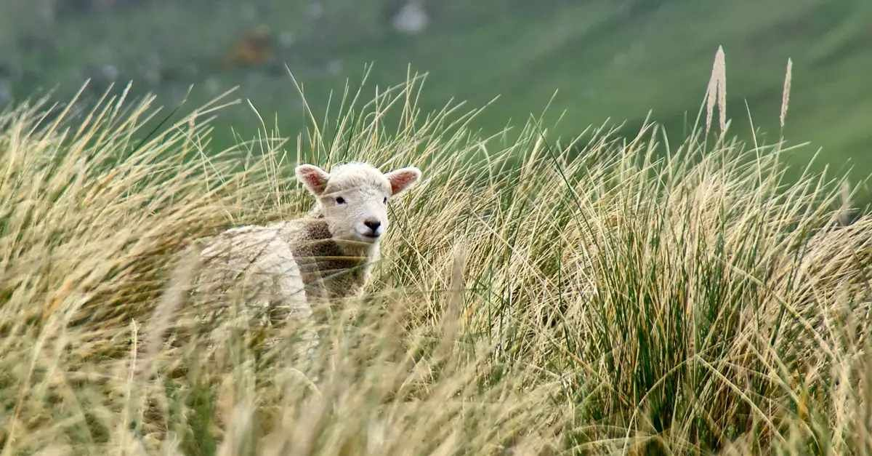
When have you felt urgency like the shepherd or the householder, searching for something lost?
In these times, where are you feeling a deep sense of vulnerability?

Slide 2
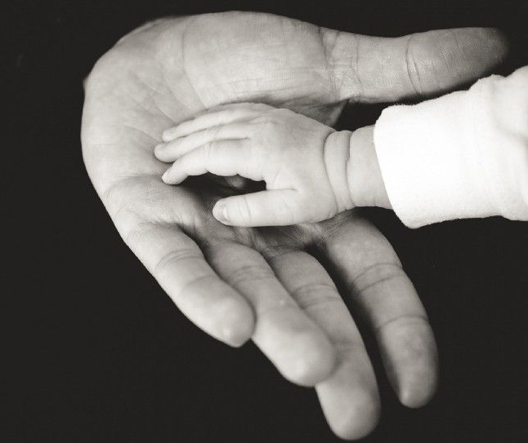
What does your sense of loss tell you about what is very important to you?
When have you yearned for something so much that you were willing to risk failure, not even holding something back to protect yourself?
Recall a time when you were vulnerable with someone – or with God.

Slide 3
The passengers of Flight 93 overcame their fear and acted out of self-giving love. Sit with them and hold their last minutes inside yourself.
What walls hold you in? How do feel about those walls – perhaps grateful?

