Slide 1
How do you love “with all your heart,
“with all your soul,
“with all your mind”?
Whom do you love
“with all your heart,
“with all your soul,
“with all your mind”?

Slide 2
Which saying holds your attention?
How does it affect you –
disturbing,
inspiring, or
something else?

Slide 3
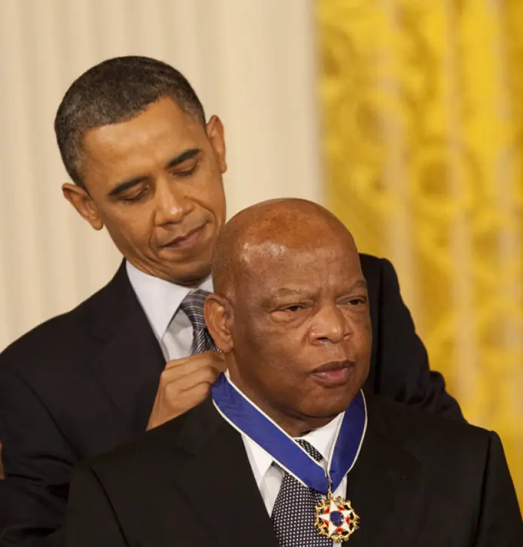
How do these ideas expand the meaning of love for you?
Where in your life could your love become more revolutionary than it is now?

