Slide 1
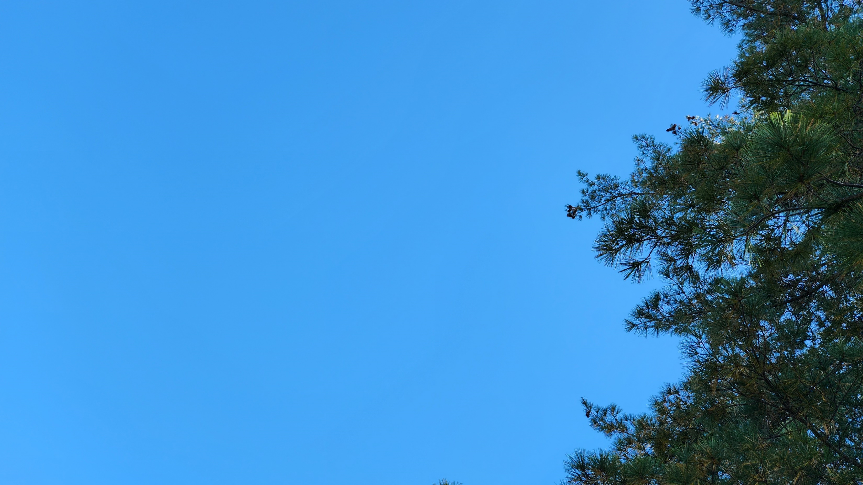
Perhaps, at times, we have all been like the Pharisee…. In what circumstances have you been more likely to judge another’s prayer or actions?
How do you respond when you
have been judged unjustly by another?
Imagine and look closely at the face of someone you perceive as greedy, crooked, adulterous, or hurtful….
What wells up in you?

Slide 2
In what aspect of your life
have you noticed or accepted
that you will always be a ‘Beginner”? – and in what aspects, not so?
Reflect on someone you know personally who is both gifted and truly humble. What do you notice?

Slide 3
What spiritual practice helps you accept your own cracks
or others’ imperfections?
In what ways do you find
your imperfections are helping
let the Light into you? How
do you find yourself resisting?
When did you recently
feel God’s mercy flow into you or a situation?

