Slide 1
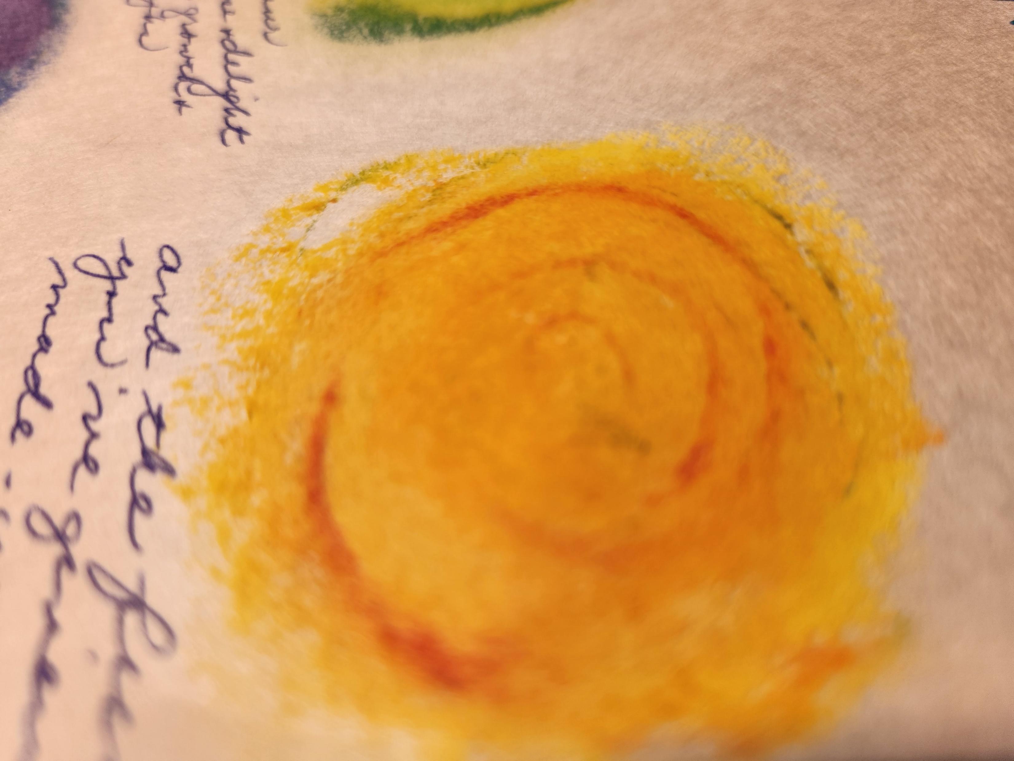
How have you felt when you have
persisted in something
despite strong resistance?
How have you felt when
someone persisted in asking you for something
that you ignored or refused?
How do you feel when
you see no change after persistent prayer?

Slide 2
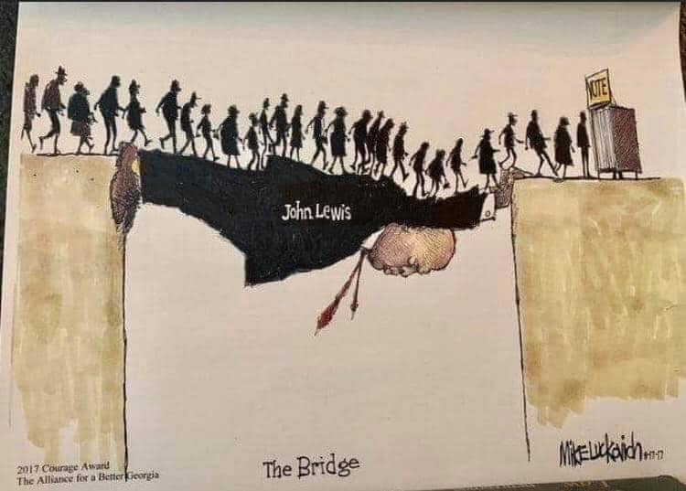
What is “the prize”
for which you persist
at this point in your life?
What bridges have you
“walked over” …
or helped to create?
How do you know
when to persist and when
to redirect your energy?

Slide 3
When have you resisted connecting with
a suffering person to avoid the risk,
the “messy entanglement”?
What was it like for you
to experience someone’s empathetic presence
in a dark time?

