Slide 1
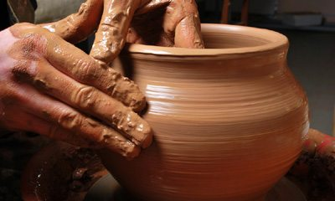

Slide 2
How has God been shaping and smoothing you through the events of recent months or years? How have you been pliable and how have you resisted God’s shaping?
We’ve just heard that eye has not seen and ear has not heard
what God is preparing for us. How do you feel about that uncertainty?

Slide 3
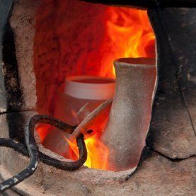

Slide 4
How do you feel about a shepherd
leaving his vulnerable flock
to search for sheep that might be
scattered in numerous locations?
Have you ever rescued someone
or been rescued from a difficult situation?
If so, how did it change your life?

Slide 5
In this parable, Jesus makes it clear that
as disciples, we should see Christ in one another.
Is this ever hard for you?
If so, what can you do about that?
What surprises or delights you
in this final judgment gospel today?

Slide 6
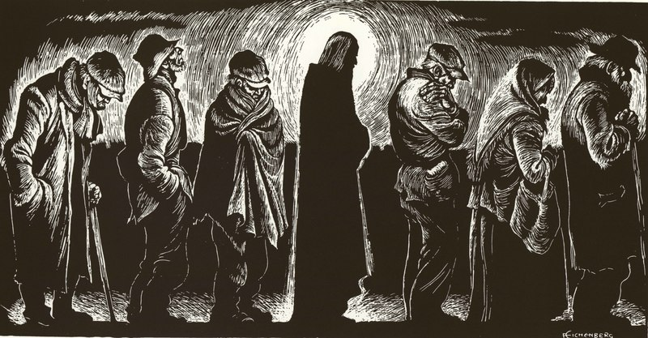

Slide 7
Pope Francis called upon the clergy
to smell like the sheep.
What would it mean to you personally
to “smell like the sheep”?
Would your comfort level allow this?
Thanksgiving is a time of community and solidarity.
In this unusual year, how can Thanksgiving
help us to expand our solidarity with others?

