Slide 2
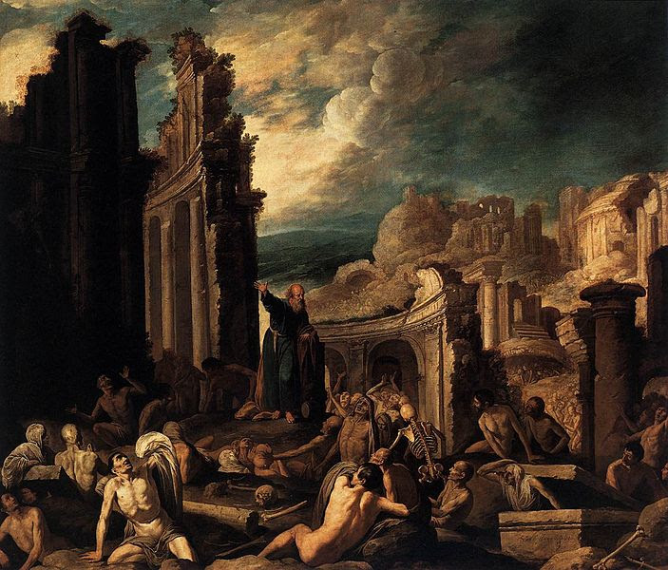
When have you witnessed someone in distress being
led by the provident hand of God to renewed life?
Where have you felt the truth
of God’s words “I will put
my spirit in you
so that you may live”?
How does the divine promise of
eternal life shape your attitude
toward your experience of
earthly life?

Slide 4
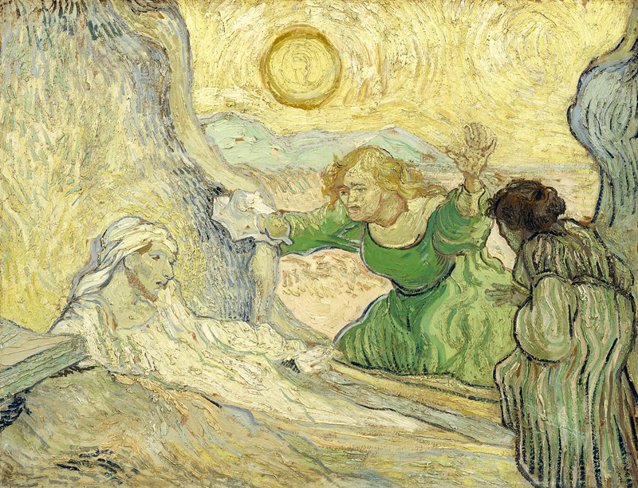
When have you felt God weeping with you?
When have you experienced
the reality of divine presence
through an expression of love?
Where have you seen
undaunted faith lead to
an outcome that seemed
practically impossible?

Slide 6
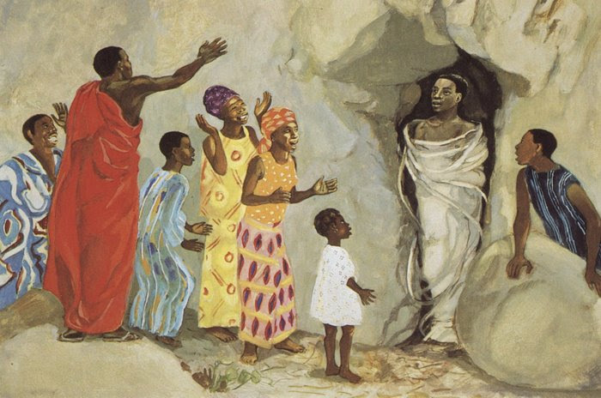
When have you realized that you were not self-sufficient, but then proved not to be alone?
What do you want to
say to God about
“accompanying us
through each other”
instead of
God ending suffering?

