Slide 1
How does your light shine?
What is it like to find light shining where you don’t expect it?

Slide 2
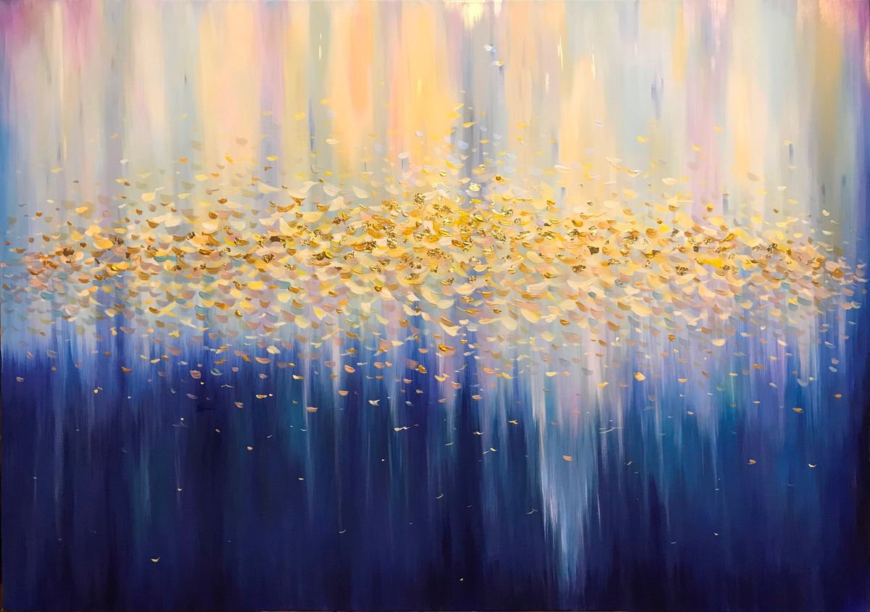
When has your struggling soul caught fire from someone else’s light?
How are you standing up and showing your soul in dark times? How have you seen this affect others?

Slide 3
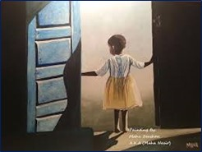
When have you experienced something wondrous that causes you to fall silent?
Talk with the Holy One about a word or phrase that feels very meaningful to you in these readings.

