Slide 1
How has the gift of courage helped you through an oppressive time?
What is the courage you pray for ?
How have God’s love and community helped you through fearful times?

Slide 2
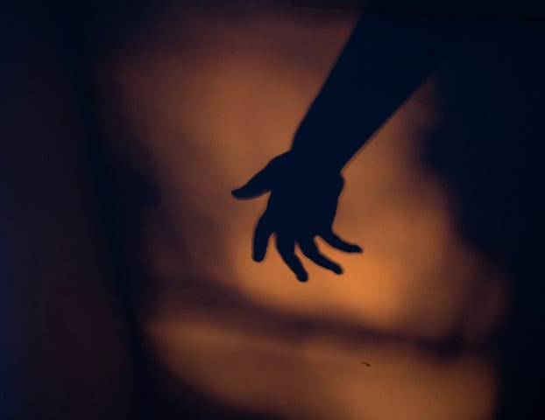
How can you avoid feeling like a victim when following Jesus leads to persecution or rejection?
What helps you discern your own motivation to speak and act for justice and mercy?

Slide 3
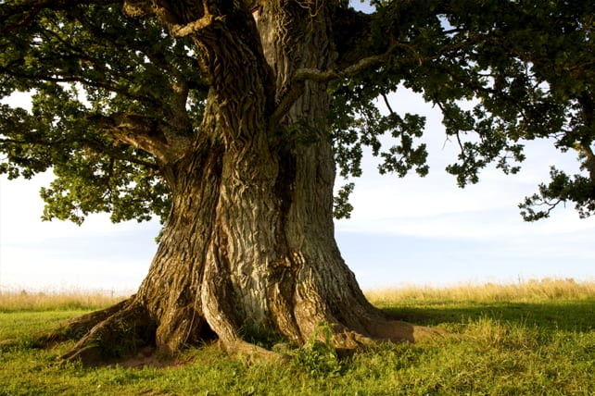
What are you most afraid of today? Converse with it and listen to what it says to you.
In what ways do you calm your fears?
Spent time with Jesus in His fear in the garden. How will you be with Him? What will you say, if anything?

