Slide 1
I will insert your questions into this space.
…and into this space.
I am putting words into the question area so you can imagine the slide format, Mary.

Slide 2
I will insert your questions into this space.
…and into this space.
I am putting words into the question area so you can imagine the slide format, Mary.

Slide 3
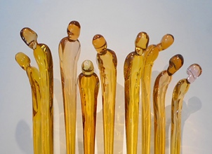
I will insert your questions into this space.
…and into this space.
I am putting words into the question area so you can imagine the slide format, Mary.

