Slide 1
What inner divisions keep you from
being “one new person”?
What inner walls separate you from others?
How can you be an instrument of Jesus’ peace in our world?

Slide 2
How did the disciples feel when they arrived at the deserted place and found a crowd? And when you seek a quiet place or time, how do you respond when someone or something crowds you?
Women religious and many others set aside time for an annual retreat. Do you try to find time for quiet? Where is your “deserted place” where you can “rest a while”?”

Slide 3
Think of an unplanned event in your life.
How could you have acted differently or noticed grace?
How can you prepare yourself to handle future unplanned events as graced moments?

Slide 4
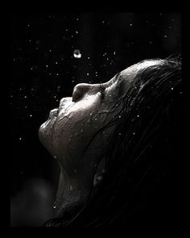
Let me taste your mercy
like the rain on my face,
here in my life.
Show me your peace.
Let us see with our own eyes
your day breaking bright.
Come O Morning, come, O light!

Slide 5
Alleluia, alleluia, Raise the Gospel over the Earth! Alleluia, alleluia, Peace and justice bringing to birth.

