Slide 1
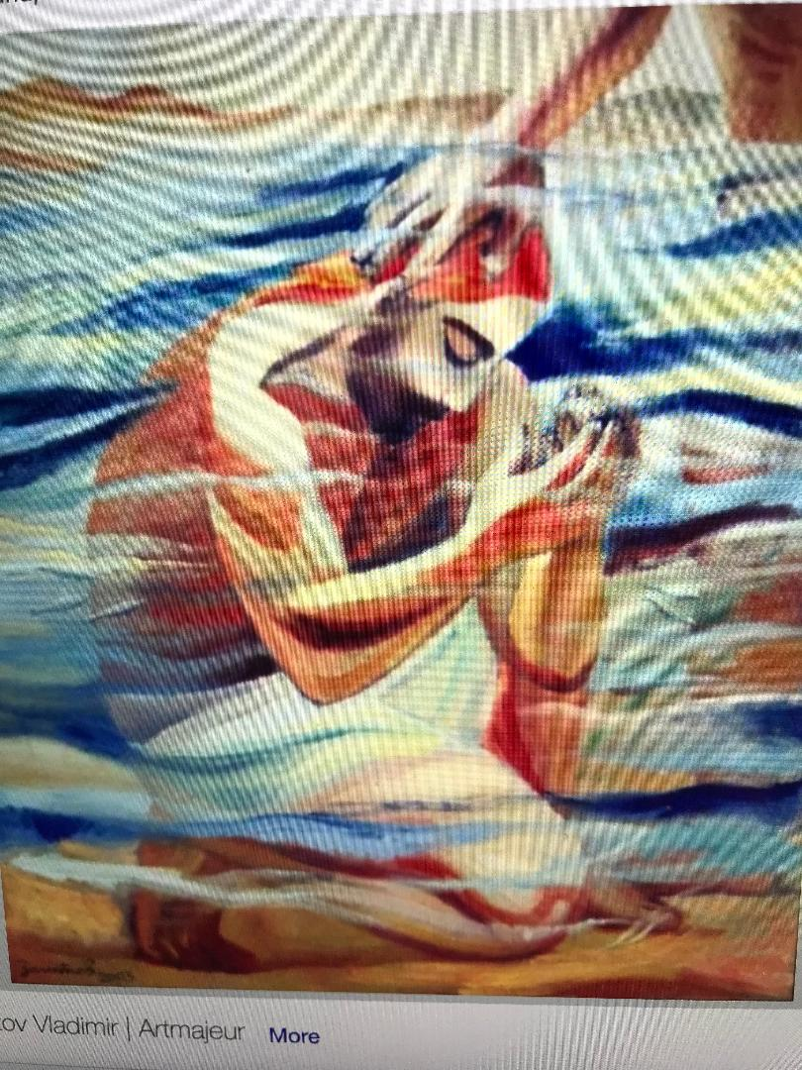
v
Whether you were baptized as an infant or as an adult, do you think of it
as a singular event or as
an evolving awareness of yourself as a beloved child of God?
How has your understanding or experience of baptism evolved
through the years?
Reflect on what it means for you to say
“I am a beloved daughter or son of God.”

Slide 2
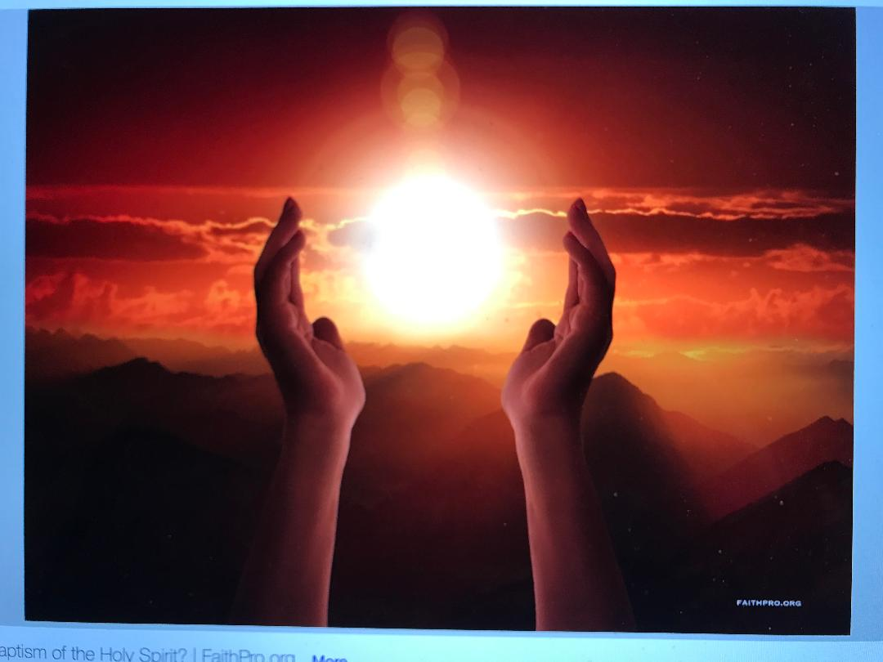
How am I being faithful to the person God wants me to be?
How am I growing in
my ability to offer unconditional love and kindness to all people – including myself?
How do I let God
partner with me as
my baptism unfolds throughout my life?

Slide 3
v
Do you freely and willingly
renew your baptismal commitment
and do you promise to live each day
with the gift of God’s grace that teaches you?
What is your free and willing baptismal commitment today?
How do you “put on Christ”?

Slide 4
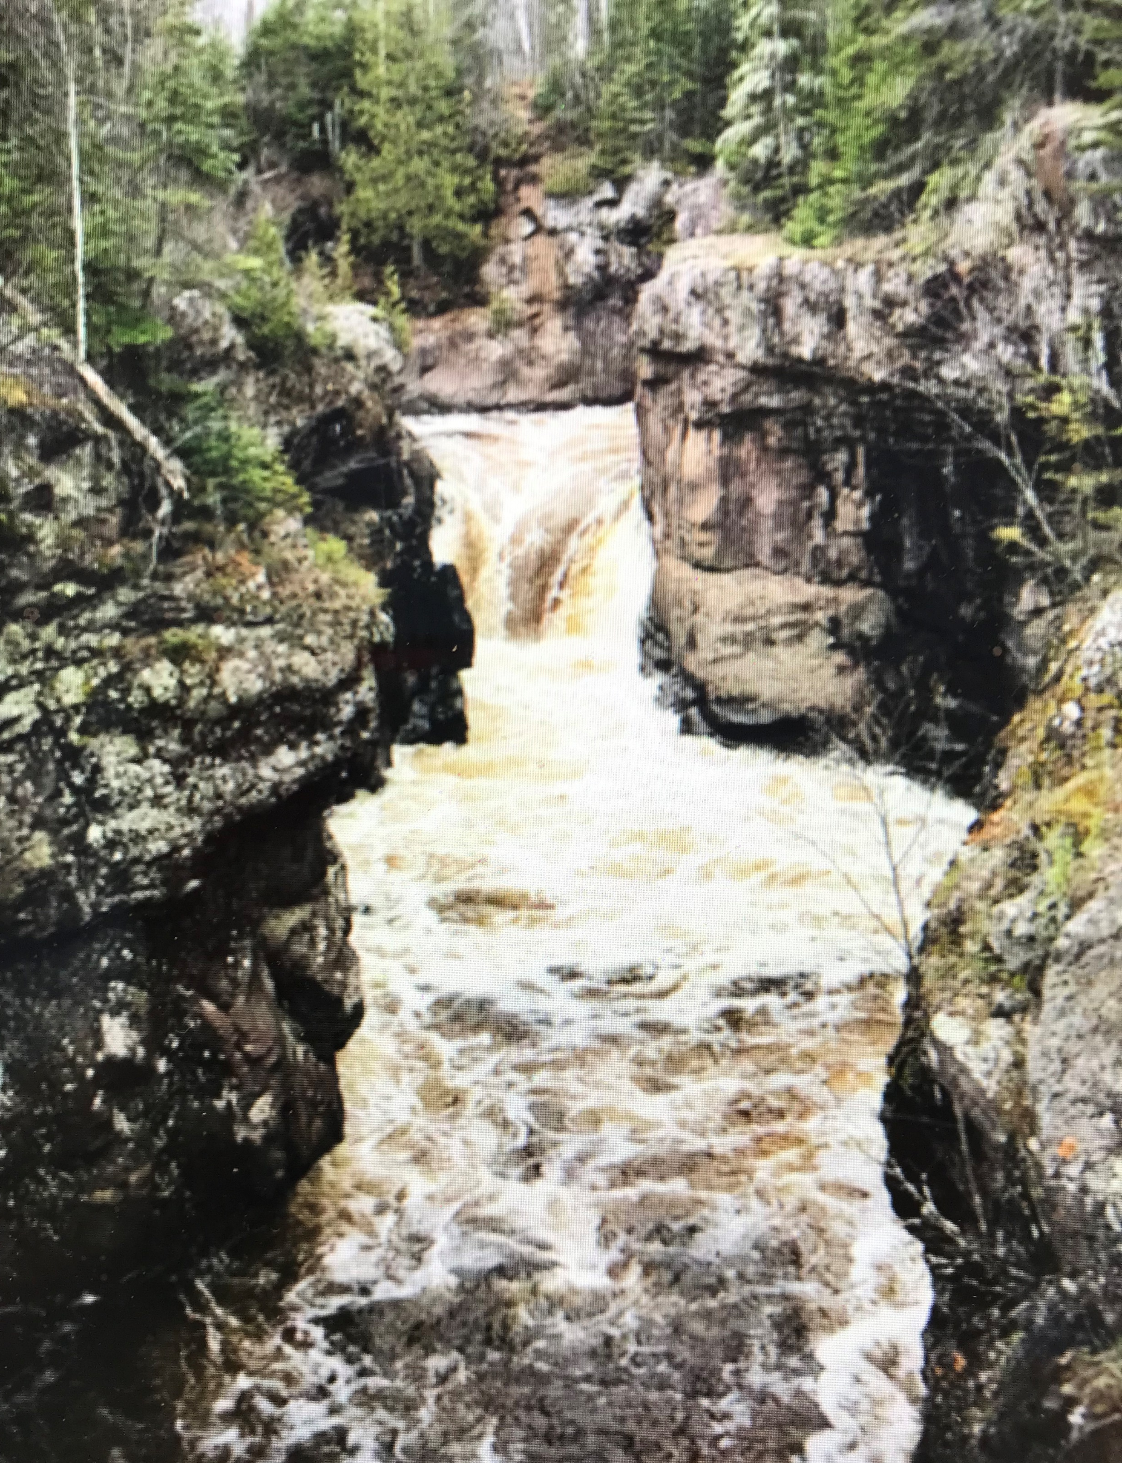
v

Slide 5
v
Do you freely and willingly
renew your baptismal commitment
and do you promise to live each day
with the gift of God’s grace that teaches you?
What is your free and willing baptismal commitment today?
How do you “put on Christ”?

Slide 6
v
Do you freely and willingly
renew your baptismal commitment
and do you promise to live each day
with the gift of God’s grace that teaches you?
What is your free and willing baptismal commitment today?
How do you “put on Christ”?

