Slide 1
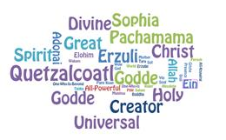
What did you hear that moved you to think differently? What did you hear that moved you to be uncomfortable? What did you hear that moved you to be challenged?

Slide 2
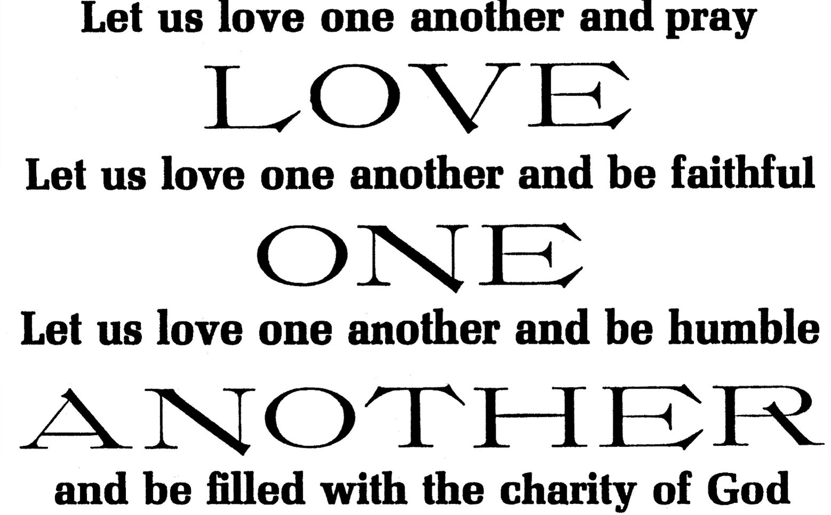
After listening to this Scripture reading, what image(s) speak(s) to you or stay(s) with you?
Recall a time when you gave generously of yourself.
Were you surprised by the “full measure” given to you?

Slide 3
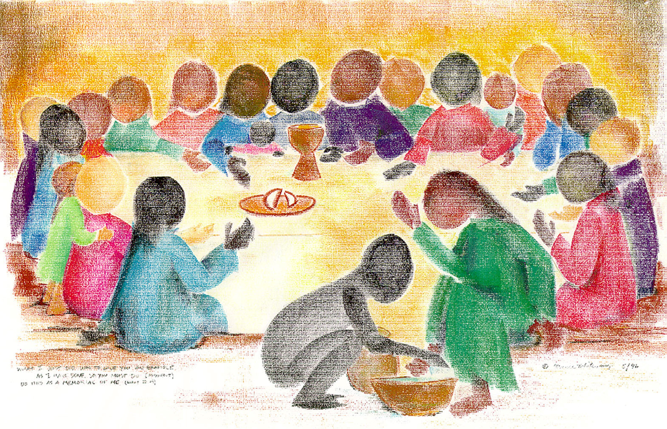
Name a time when you lived Eucharist. What touched you?
What image(s) come to mind?

