Slide 1
v
When you, like Peter, have received unwanted advice from a well-meaning friend or stranger,
what was your reaction?
How have you felt when you have
“pulled out into deep water,” trusting in God, and found that “your nets were at the breaking point”?

Slide 2
v
What words from this song move you toward
trust in the goodness of God?
What do you offer of yourself to God and to others?

Slide 3
v
When have you had a transformative encounter with Christ? Ponder its meaning in your life.
How can you honor that experience this week?
If we are to be Christ to one another, what can we do to encourage and empower
the prophets of our day to speak,
or the saints of our day to minister?

Slide 4
v
What does it mean to have “love empower us to respond beyond our feelings”?
When you feel righteous anger, how do you consider "what love embraces" and "what love resists"?

Slide 5
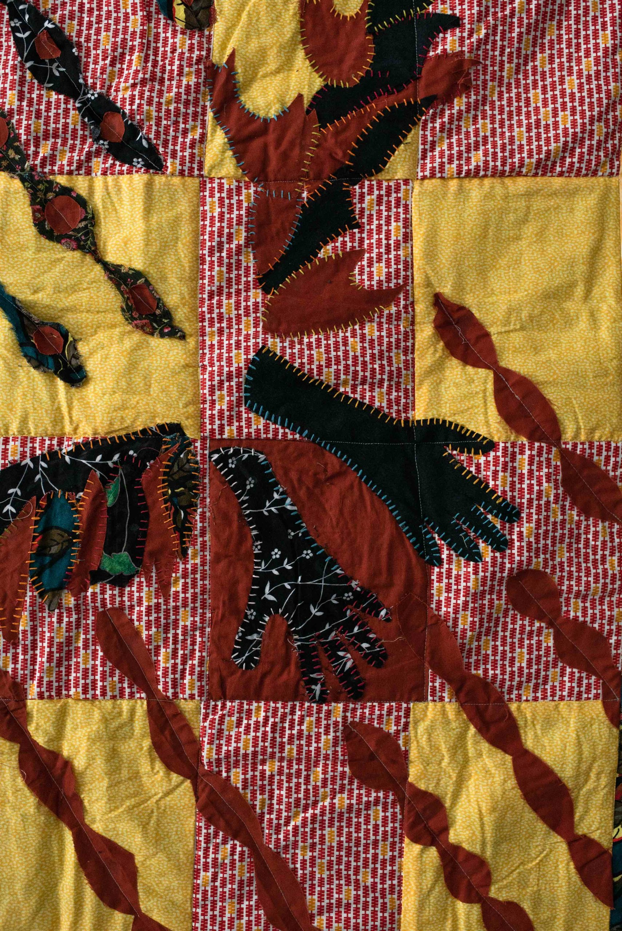
v
How are you challenged to respond when Christianity is being used to define and defend nationalism?
Whose voice are you ignoring because it makes you uncomfortable?

