Slide 1
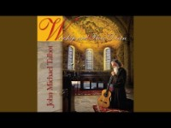

Slide 2
METANOIA

Slide 3
Imagine yourself there in the crowd, waiting in curious attention, scintillating anticipation, and tingling expectancy to hear what this strange man has to say. How do you feel as you listen to this new message?
What is the context of your own story as you listen with awaiting ears? Who are you and where are you as you enter the Advent invitation?

Slide 4
How do you make a straight path for God in your heart?
Why could it be valuable for you to spend time
“in the desert”?

