Slide 1
Which of the mentioned gifts of the Spirit were given to you and how do you make use of it to ‘uphold the downtrodden’?
Imagine in detail a peaceful encounter of “wolves and lambs” you would invite to gather in your hospitality. Conversation? Food? Music?

Slide 2
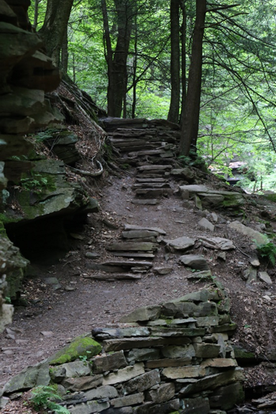
About what do you most need to change your heart or mind? How do you commit to begin?
What obstacles clutter God’s path to you this Advent? How do you commit to make the path straight?

Slide 3
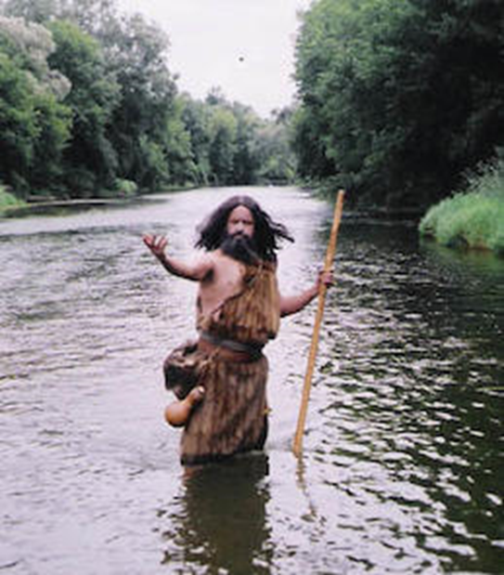
When have you experienced waiting that became a needed purification?
"What one word or small action have you noticed that points to God's coming this year?“
What change of heart do you ask of Christ this Advent?

