Slide 1
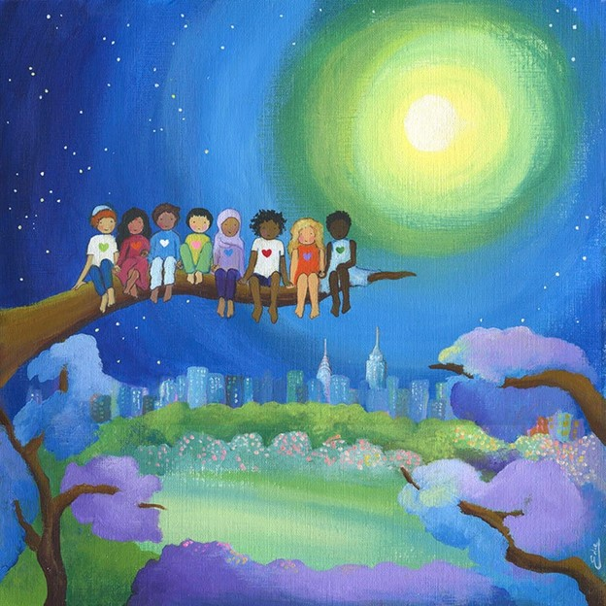
Think of a family member with whom you have been less than loving. How can you reach out in love to this person?
How has your family (natural or chosen) become a herald of God’s family on earth?
What does it mean to you to be a child of God? Do you see others as also children of God?

Slide 2
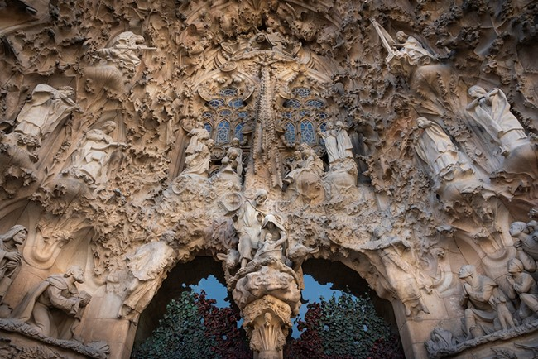
v

Slide 3
v
What image or story expresses the incarnation for you today?
How do you make the incarnation of 2000 years ago a present reality in your life?

