Slide 1
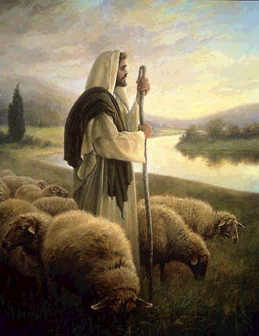
Imagine yourself as one who is standing firm and being a shepherd to God’s people.
How would you ask for strength?
What happens within your heart when you hear that the greatness of God “shall reach to the ends of the earth;
he shall be peace”?

Slide 2
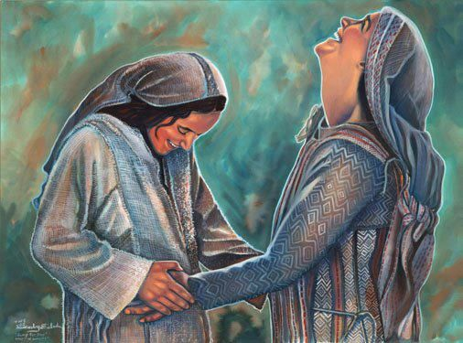
Imagine yourself there when the two close cousins meet. Let your feelings speak to you. When have you felt a connection – to Mary or Elizabeth, or to another person – that strong? How do you keep your close connection?
How do you feel about being able to turn to someone else when you feel isolated and overwhelmed? To whom might you turn?

Slide 4
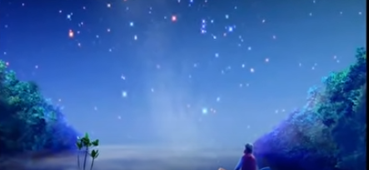
When have you had a period of waiting for
an important life event to unfold? How did God accompany you?

Slide 5
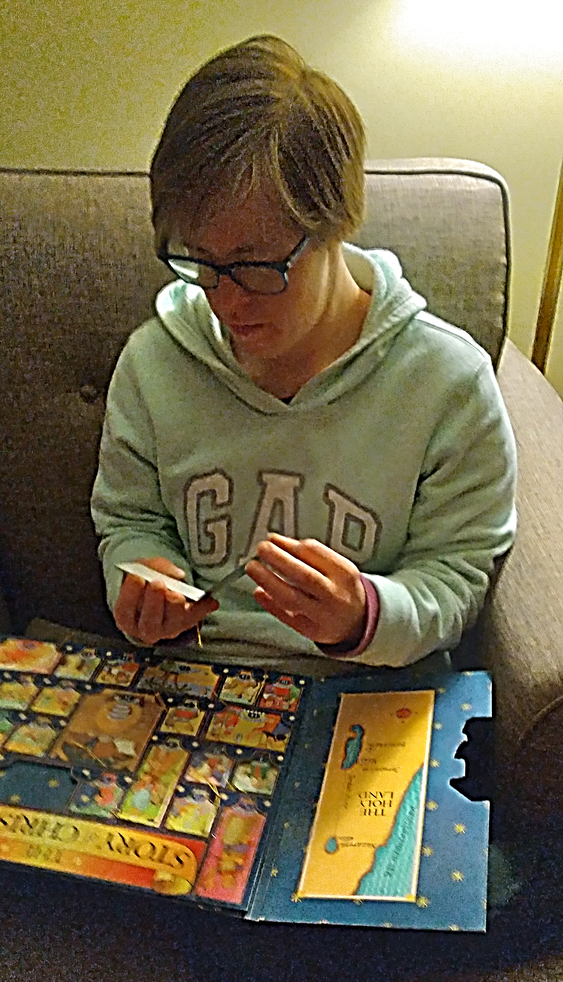
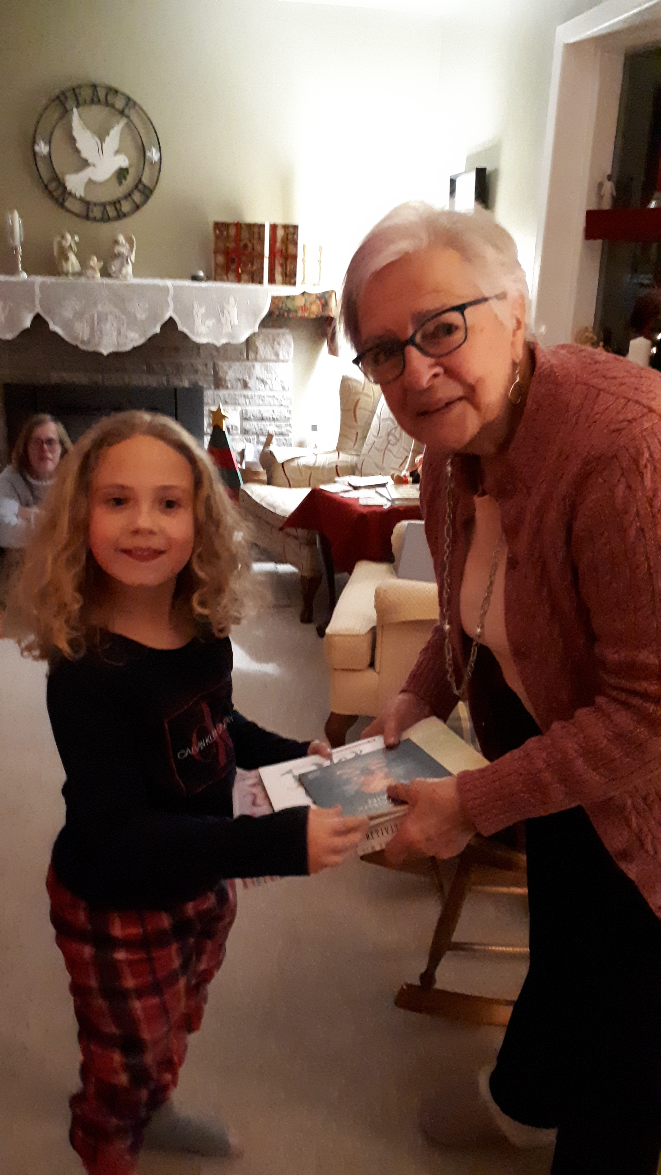
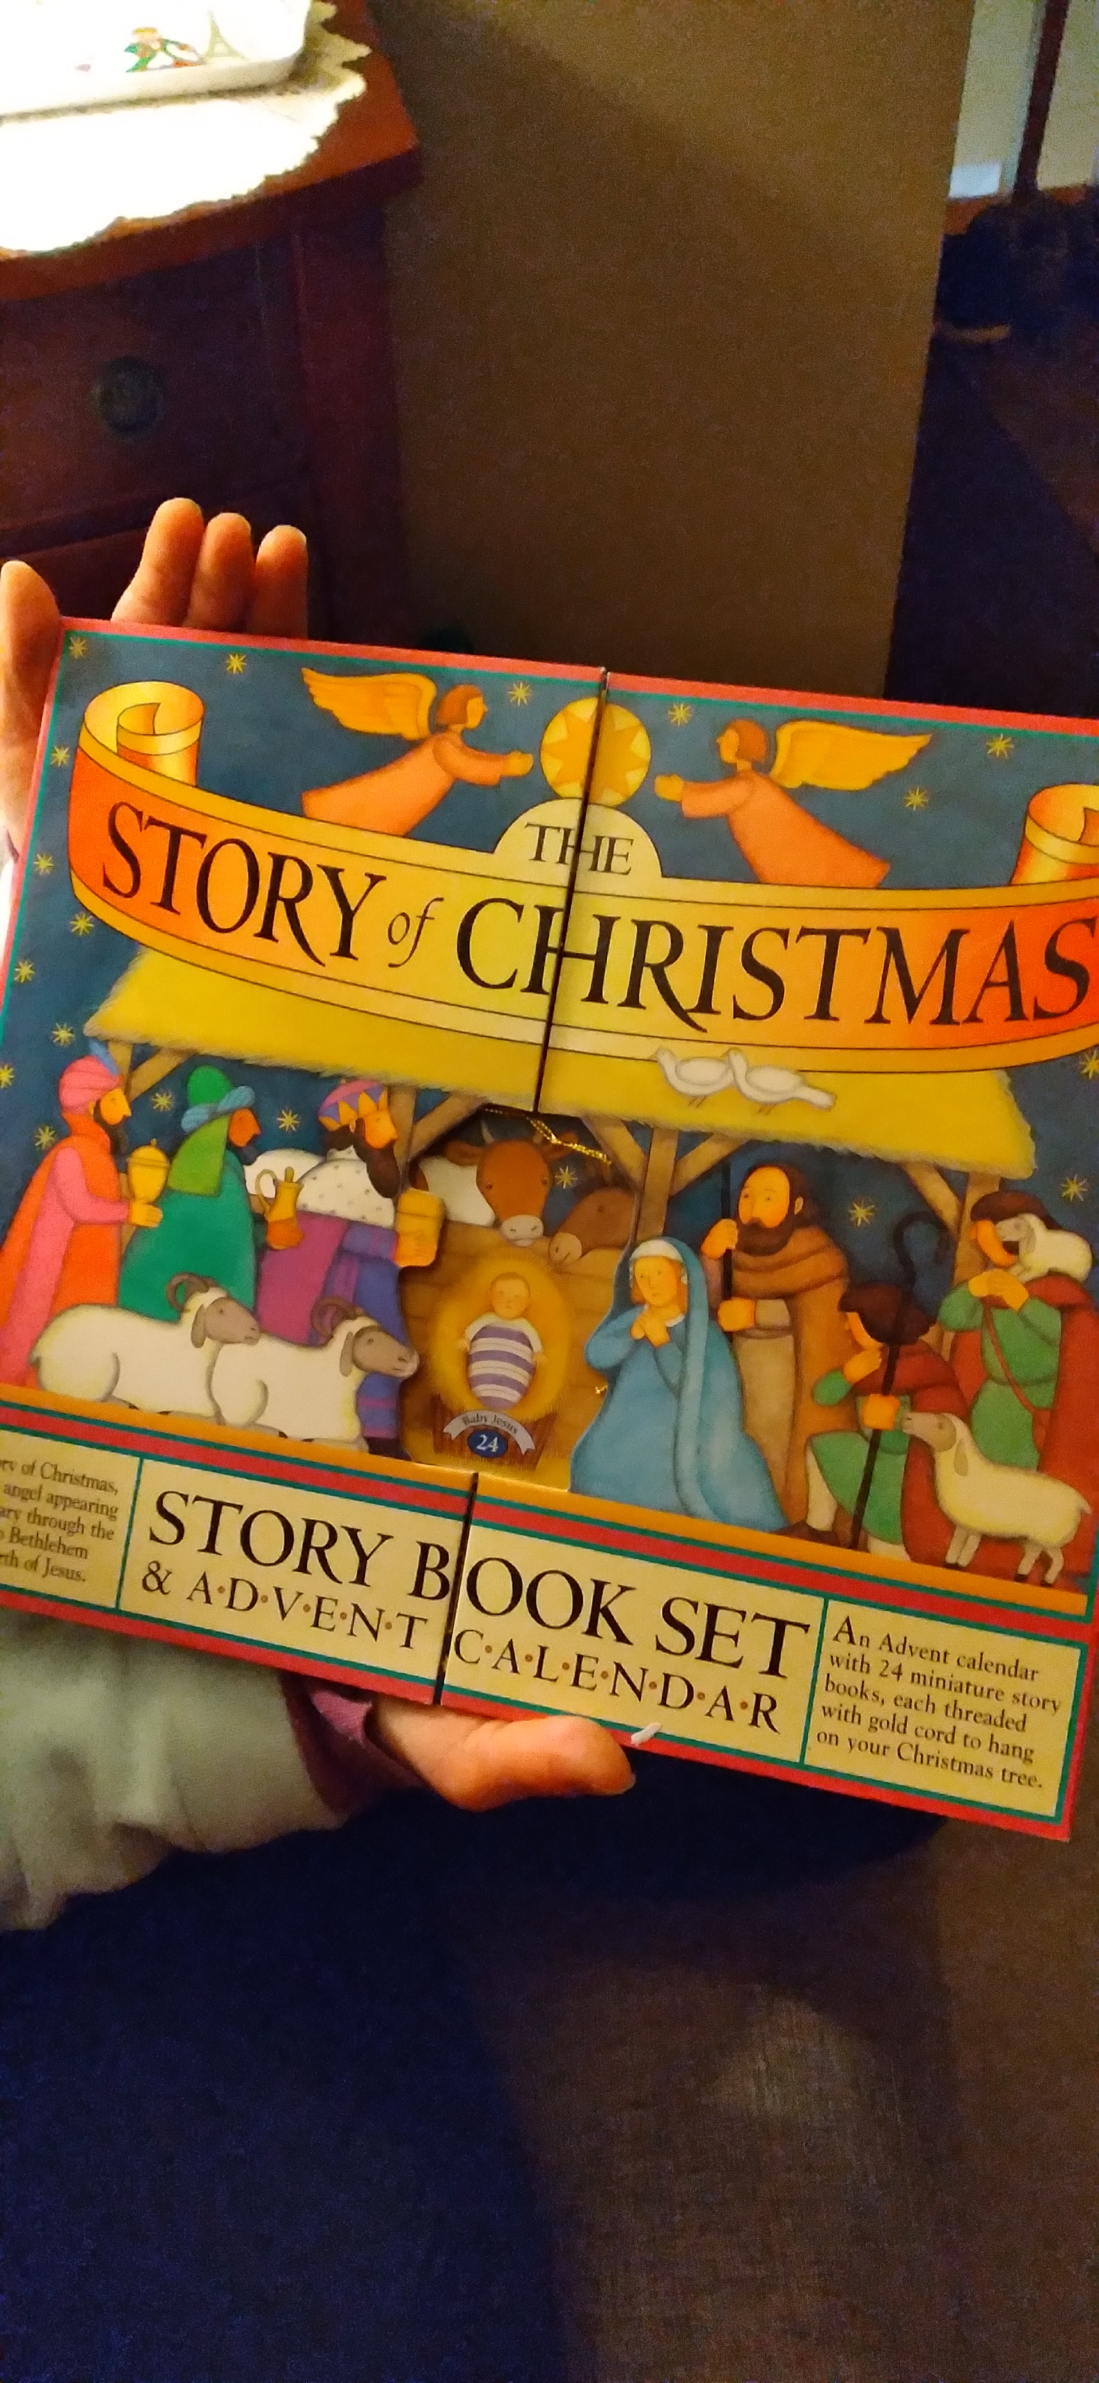
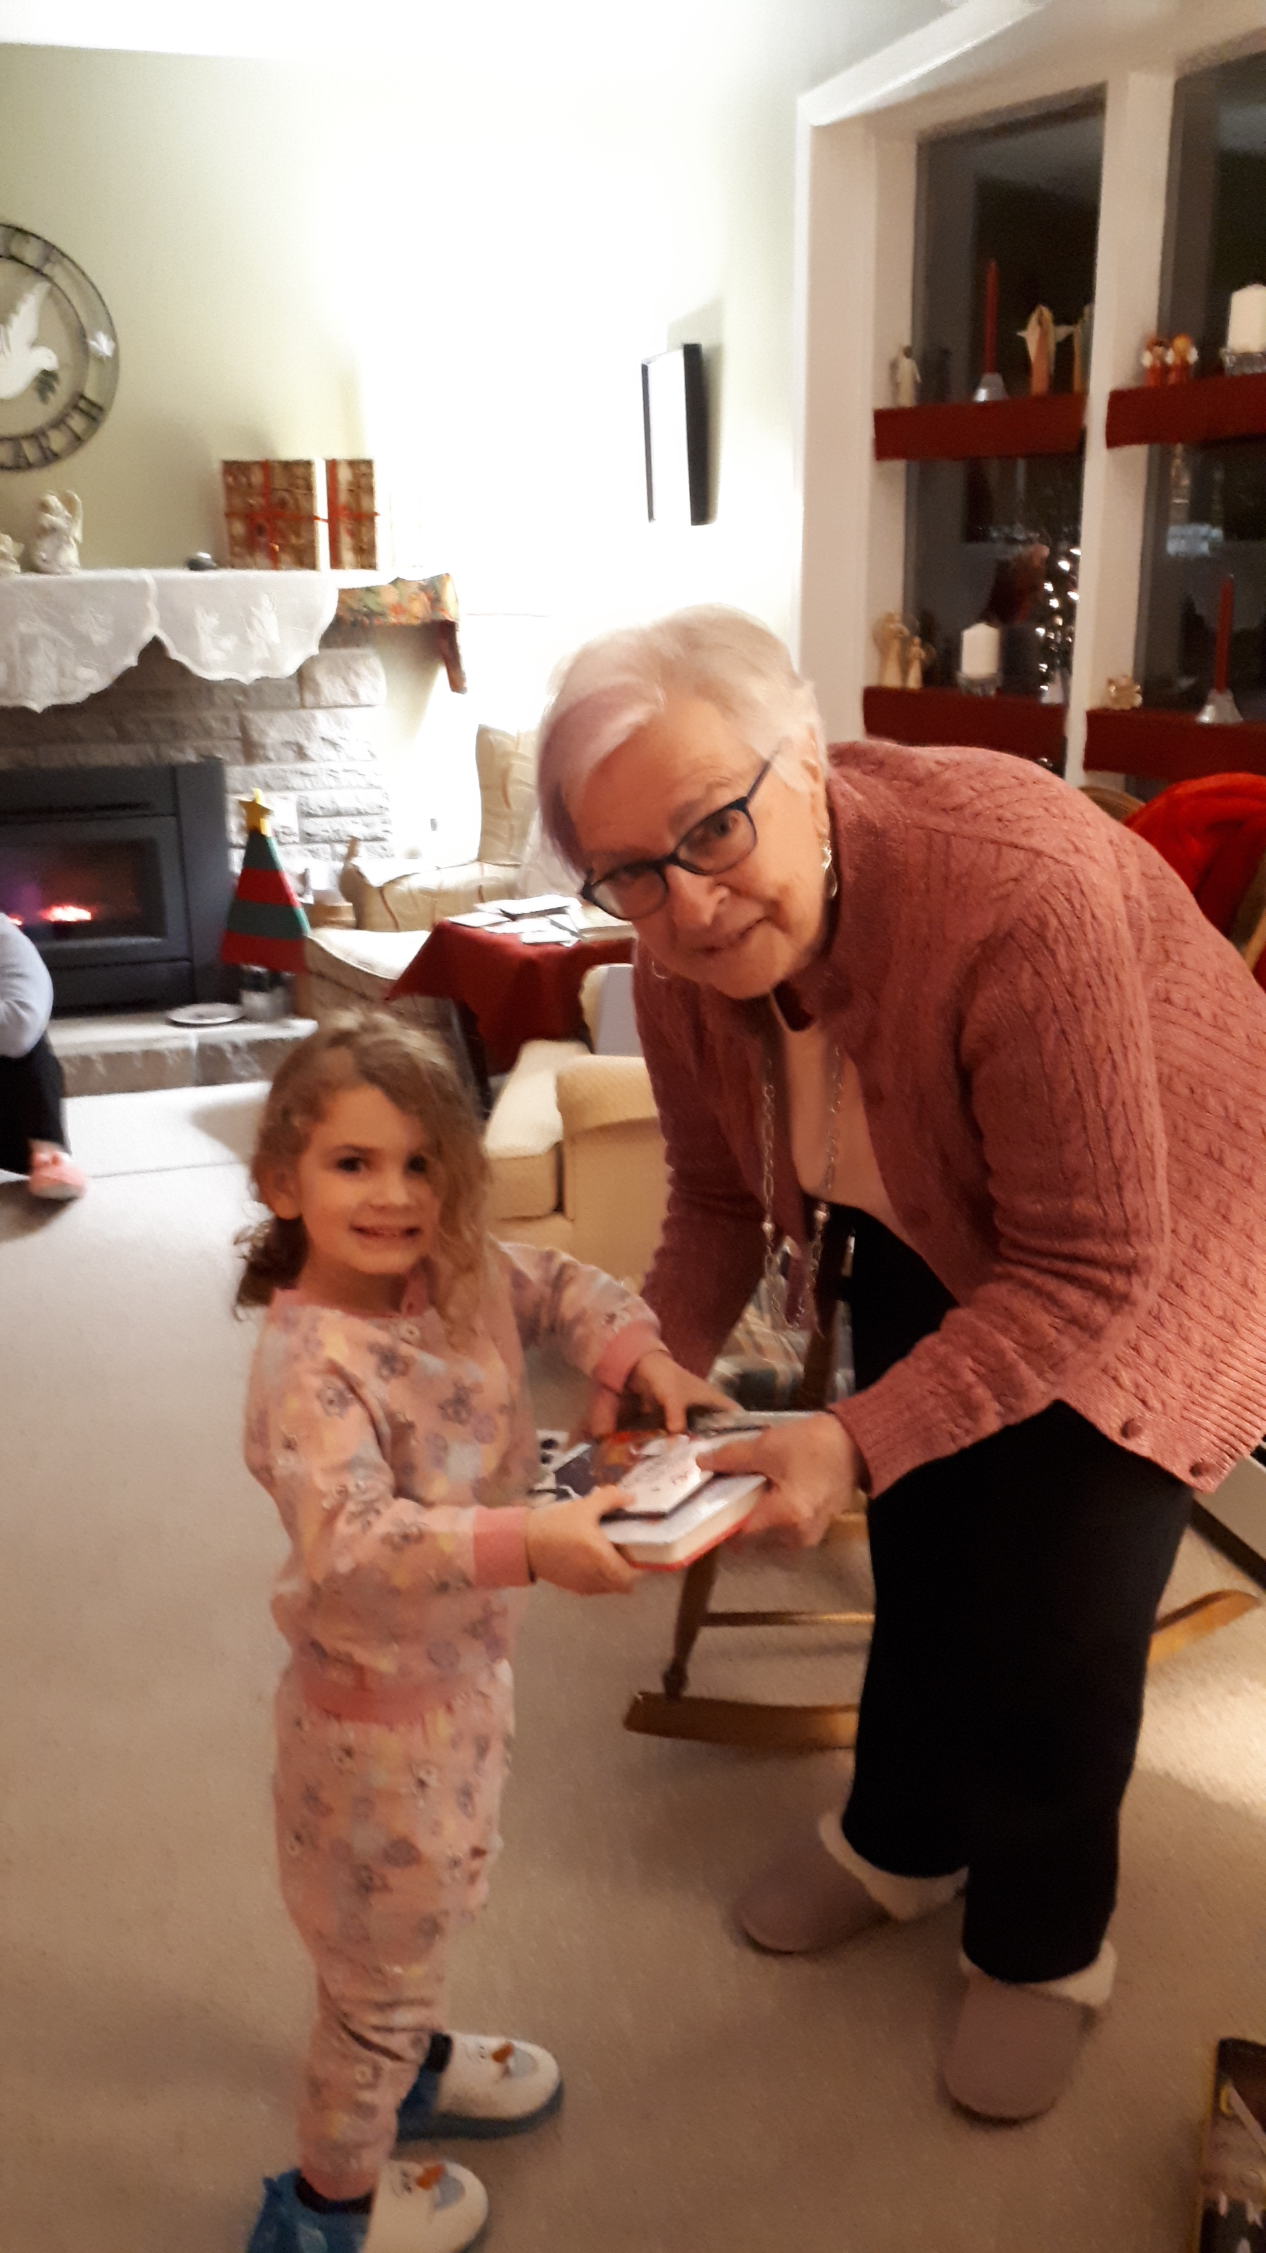

Slide 6
