Slide 1
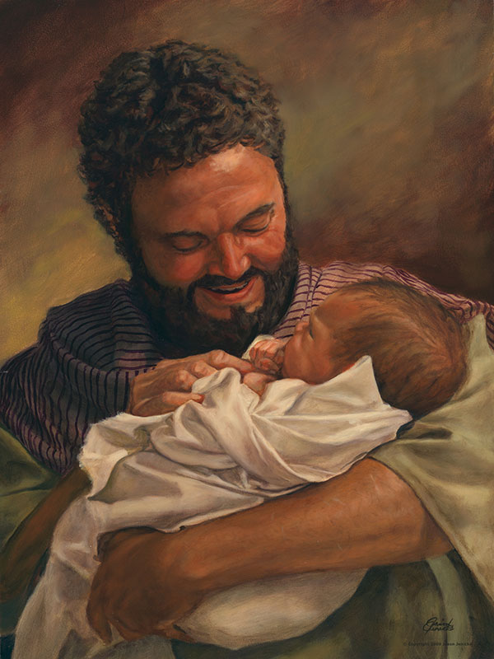
What tension are you feeling now between law and love? Imagine talking with Joseph.
How does it feel to co-mingle your “Yes” with Mary’s?
On whom do you rely to see what is possible? Whose "yes" impacts your own?

Slide 2
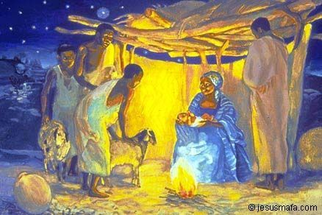
v
How are you different from the “you” who heard this story last year?
Who in this story would you like as your companion or guide as you enter 2022?

Slide 3
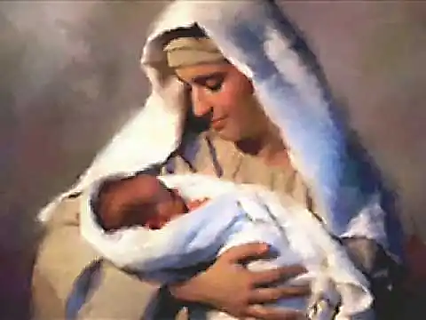
How do I live the question of the song? What child IS this?

