Slide 1
What emotions have come to you while listening to this letter?
Reflect on the expressions of love you just heard. Can you stay with this emotion?
What memories of your
own life experience
come forth as you listened
to this reading?

Slide 2
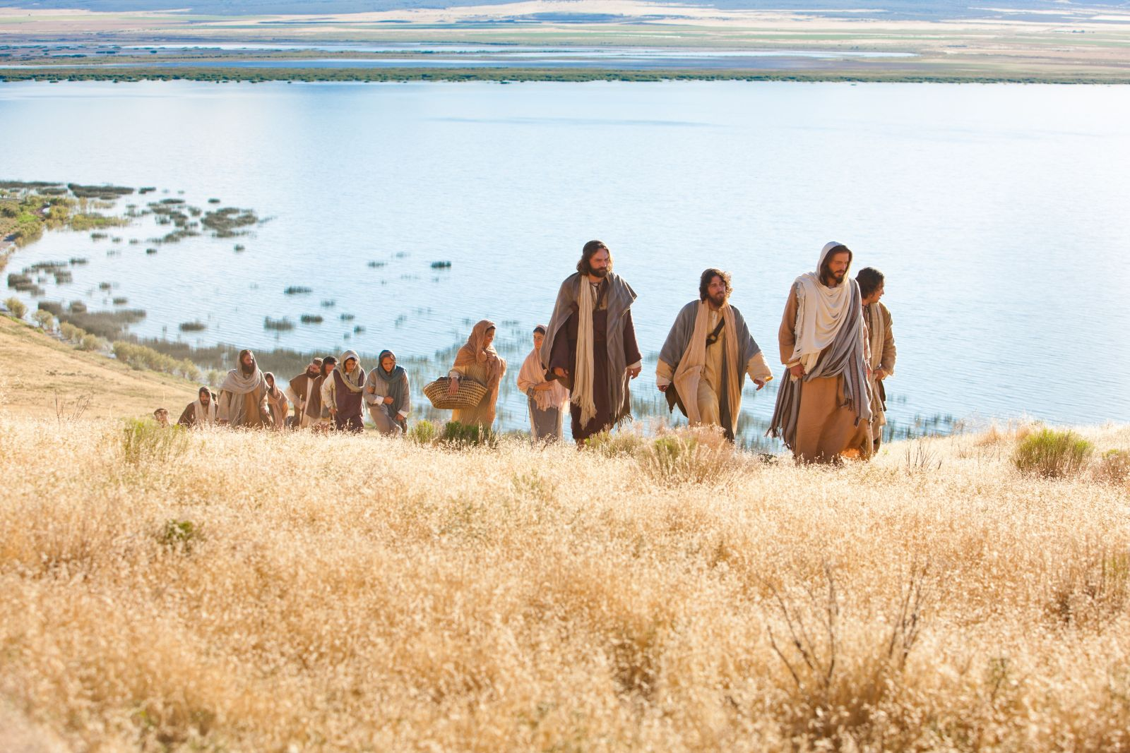
Imagine yourself in the group who have been following Jesus. Do you find all his teachings hard to accept as many did, or are you there near Jesus willing to go with him no matter how hard and risky it might be?
What is your reaction to
Jesus’ saying: “The words I
have spoken to you are
Spirit and life. But there are
some of you who do not believe.”

Slide 3
When have you tried to listen
from a cultural context
other than your own?
How did you react and
how did you feel as a result?
What do you feel about:
what the Lord requires of you?

