Slide 1
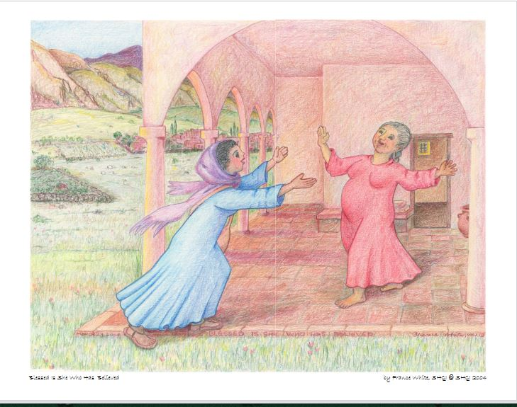

Slide 2
When have you felt something unexpected taking life and growing in you?
Remember and savor a time when someone recognized something in you and expressed joy or appreciation.
With whom do you share your most important news? What do you hope for from them?

Slide 3
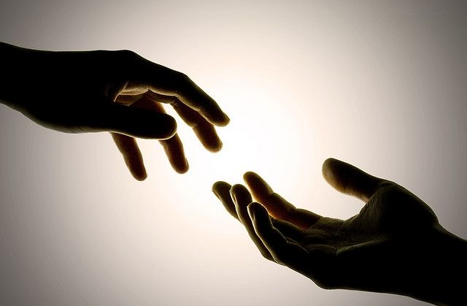

Slide 4
How do you experience the goodness and mercy of God?
Ponder a time when you hoped God would reach out and take you by the hand.

Slide 5
What question pesters your heart these days?
What would it be like for you to live into the question, to stumble forward, more than to seek answers?

