Slide 1
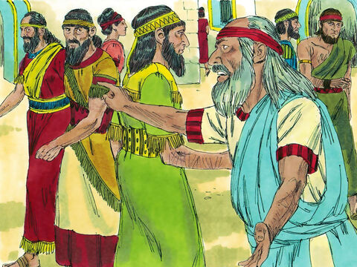
The call of e
Whom do you experience as prophets alive today? What makes them a prophet and what is their call to you?
When have you felt called to be a prophet, to convey God’s message? How did that situation feel?
The Call of Ezekiel

Slide 2
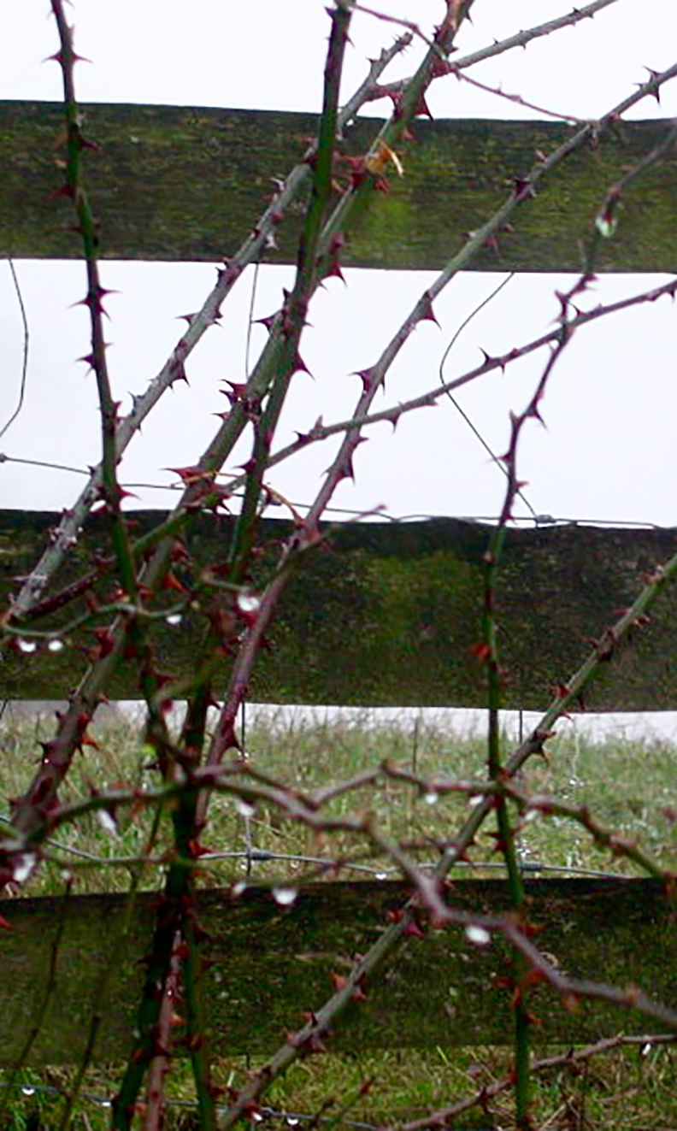
Whom do you experience as prophets alive today? What makes them prophets and what is their call to you?
When have you felt called to be a prophet, to convey God’s message?
How did that situation feel?

Slide 3
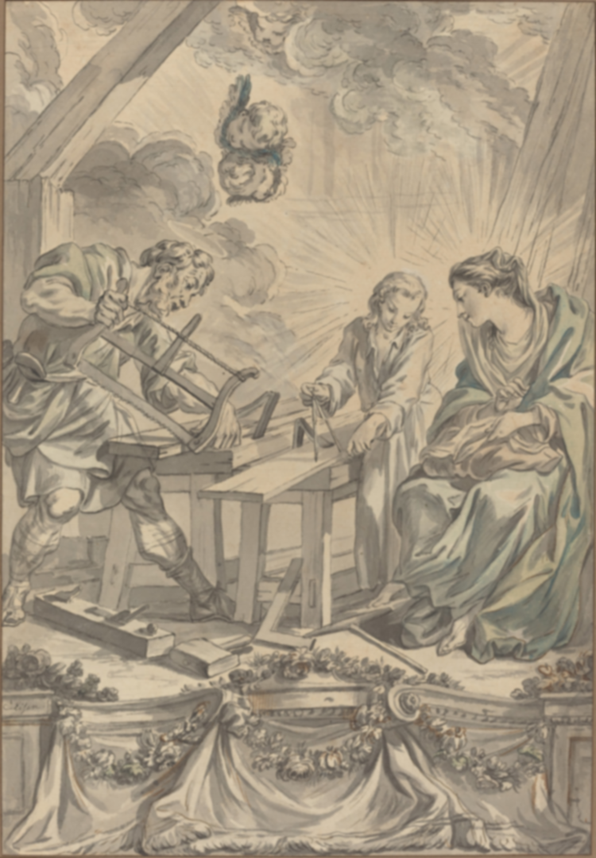
How do you think Jesus felt when his neighbors rejected him?
The people of Nazareth were not ready for God to act among them. Who or what in your town creates space for the Spirit to work?
The Holy Family in the carpenter’s shop

