Slide 1
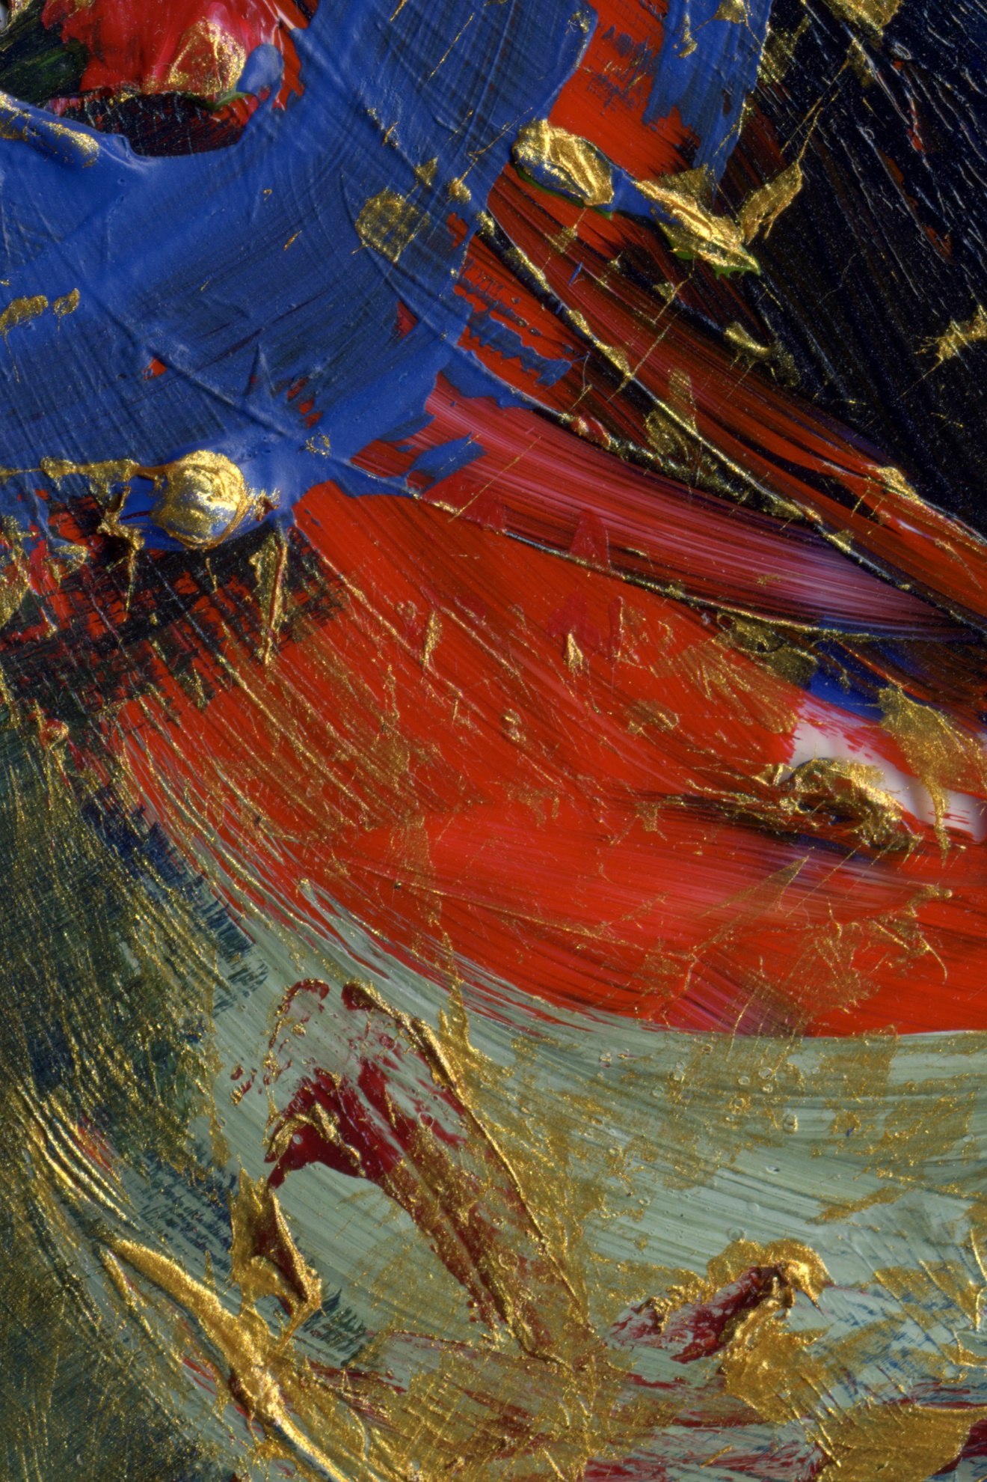
“Beloved is where we begin.”

Slide 2
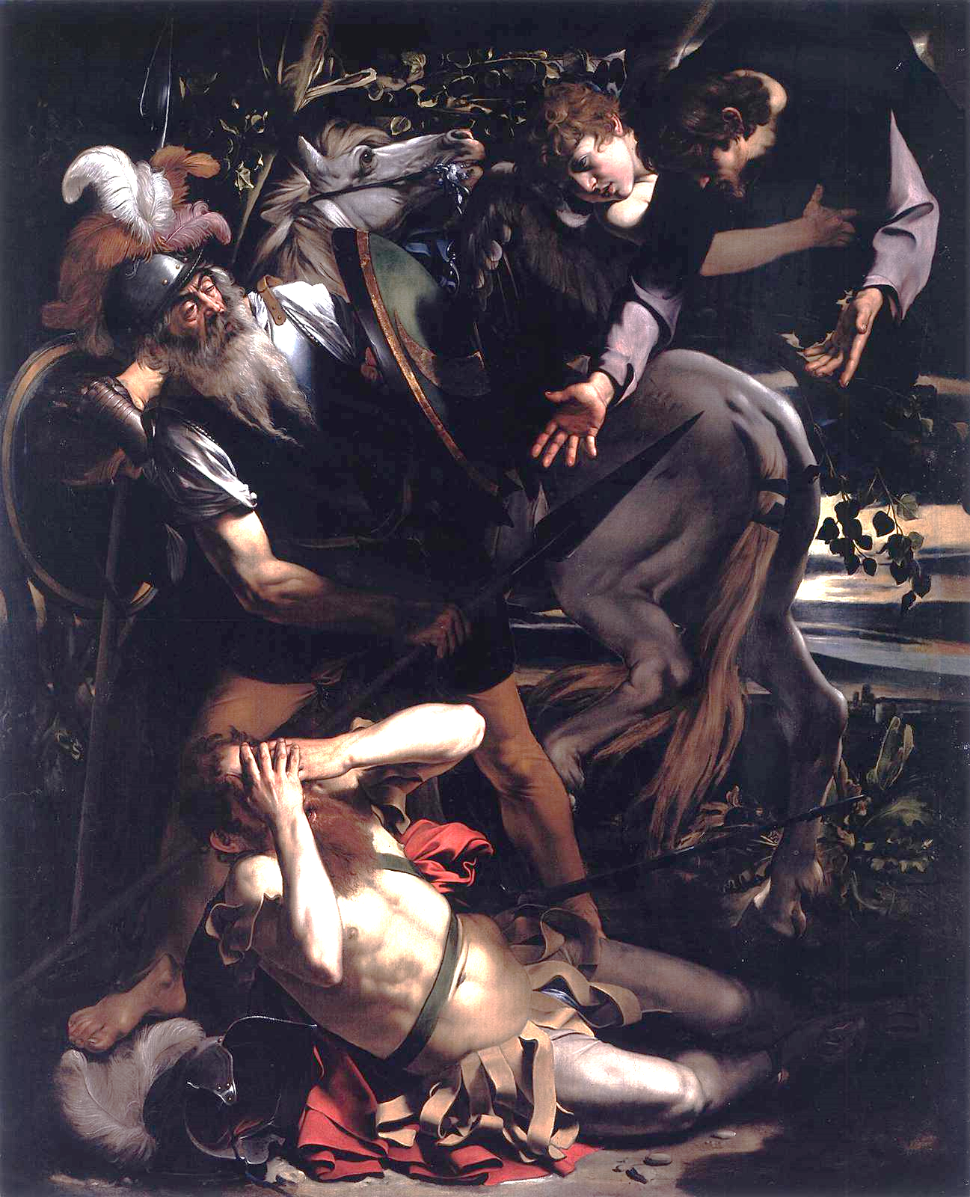
Who is your Barnabas? When you face a spiritual quandary, who or what do you trust for insight?
What would it look like to you for your church to be “at peace”?

Slide 3
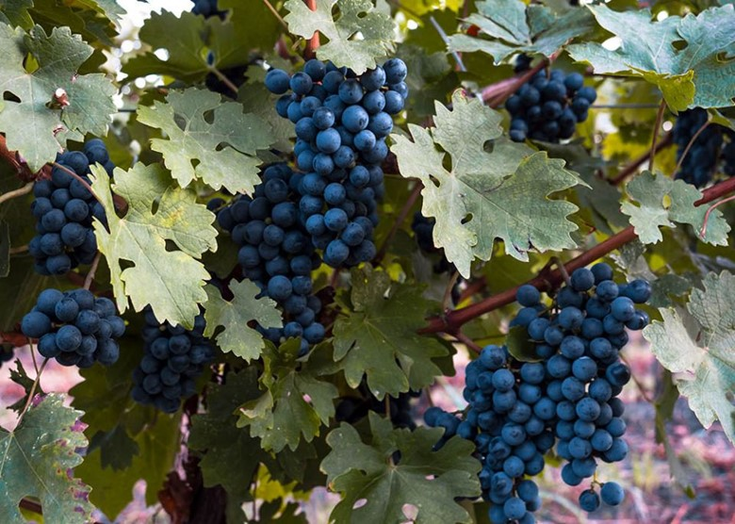
What vines keep you
connected to the source of divine love and fruitful behavior?
In what ways has your
heart sought to separate
you from that life-giving
love?
How has a
“whatever you wish” request been fulfilled for you?

Slide 4
What has motivated you to speak out and to act boldly as a witness?
What has helped you nurture and grow your relationship with God;
how has pruning played a part?

