Slide 1
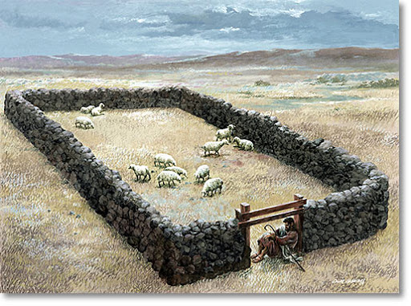
What surprises you about the pastures where Jesus has led you? Have any of them been arid or depleted?
What does it mean to you, to “have life to the full”?

Slide 2
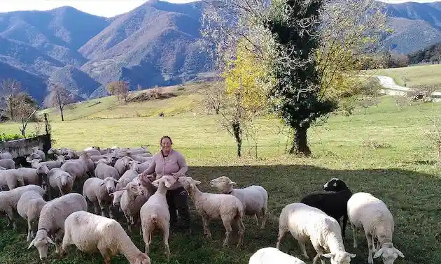
Reflect on a time when you felt a wolf had scattered
the flock you where you belong.
Who are or have been your good shepherds? When did you follow their lead and when did you resist?

Slide 3
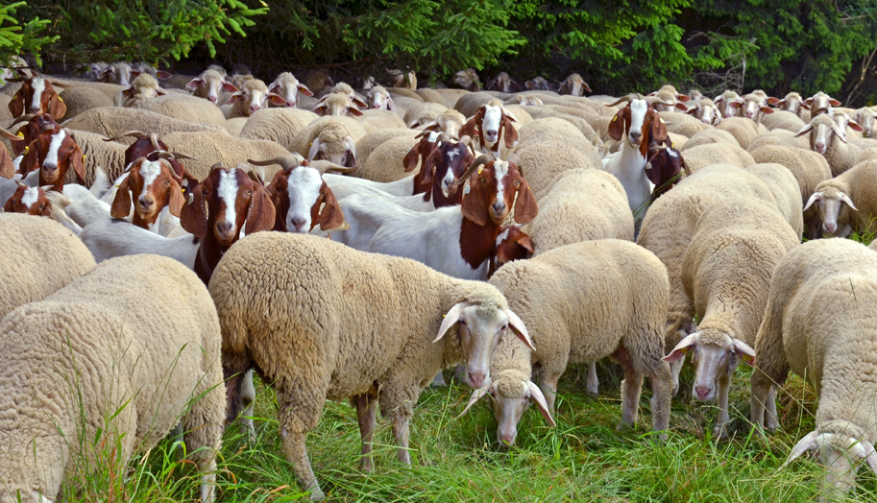
For whom do you resist laying down your life?
A large flock has many needs. How do you choose where and how to use your life? How have your choices changed during your life?

