Slide 2
Abraham said “Here I am” when God called to him. How do you hear God speaking to you?
If you recognize the “human sacrifice” of capital punishment, war that kills innocents, and tolerance for the suffering of refugees and poor people, how do you feel, what do you do?

Slide 3
How do you feel about God handing over his Beloved Son for us all?
How does knowing that Jesus intercedes for us always, without our asking, change prayer for you?

Slide 4
How can you better listen to Jesus?
What words of Jesus have you questioned or not understood?

Slide 5
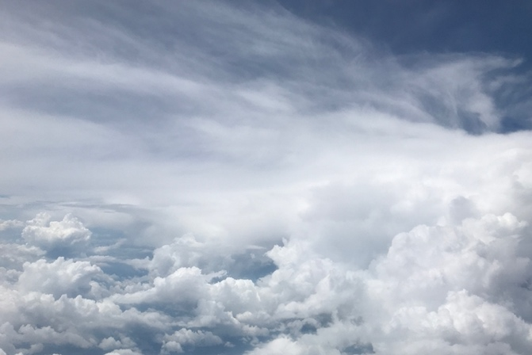
Summon out what I shall be…

Slide 6
